Slide 1
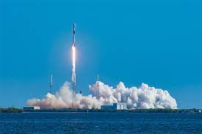
SPACE
RACE
WITH
DATA
SCIENCE

Slide 2
Outline
Executive Summary
Introduction
Methodology
Results
Conclusion
Appendix

Slide 3
Executive Summary
Summary of Methodologies
Data Collection
Data Wrangling
EDA with Data Visualization
EDA with Data SQL
Building an Interactive Map with Folium
Building a Dashboard with Plotly Dash
Predictive Analysis (Classification)
Summary of all Results
EDA Results
Interactive analysis
Predictive Analysis

Slide 4

Introduction
Project background and context
SpaceX advertises Falcon 9 rocket launches on its website, with a cost of 62 million dollars;
other providers cost upward of 165 million dollars each, much of the savings is because SpaceX can reuse the first stage.
Problems you want to find answers
The project task is to predicting if the first stage of the SpaceX Falcon 9 rocket will land successfully

Slide 5

Methodology
Section 1

Slide 6
Methodology
Executive Summary
Data collection Methodology:
SpaceX Rest API
Web Scrapping from Wikipedia
Perform Data Wrangling:
One Hot Encoding data fields for Machine Learning and data cleaning of null values and irrelevant columns.
Perform exploratory data analysis (EDA) using visualization and SQL.
Perform interactive visual analytics using Folium and Plotly Dash.
Perform predictive analysis using classification model:
LR ,KNN,SVM,DT models have been built and evaluated for the best classifier.

Slide 7
Data Collection
SpaceX API
The following datasets was collected:
SpaceX launch data that is gathered from the SpaceX REST API.
This API will give us data about launches, including information about the rocket used, payload delivered, launch specifications, landing specifications and landing outcome.
The SpaceX REST API end points, or URL, starts with api.spacexdata.com/v4/.
Another popular data source for obtaining Falcon9 Launch data is web scraping Wikipedia using BeautifulSoup.
Use SpaceX
REST API
Returns SpaceX data in JSON
Normalise data into csv file
Ready for data consolidation & wrangling
Get HTML response from wikipedia
Extract data using beautiful soup
Normalise data into csv file
Webscrapping

Slide 8
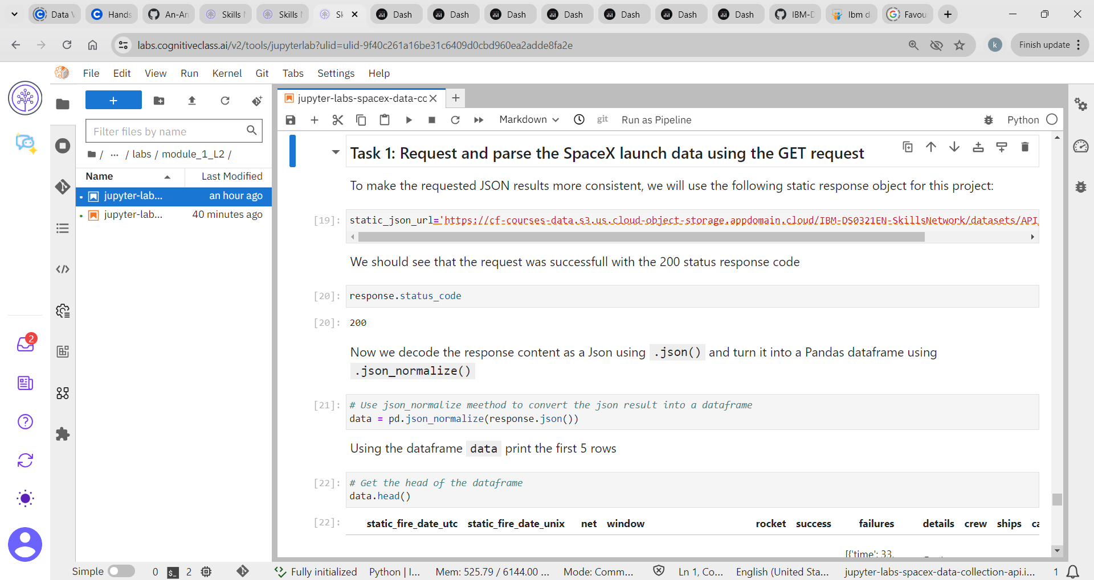
Request and sparse the SpaceX launch data using the GET request

Slide 9
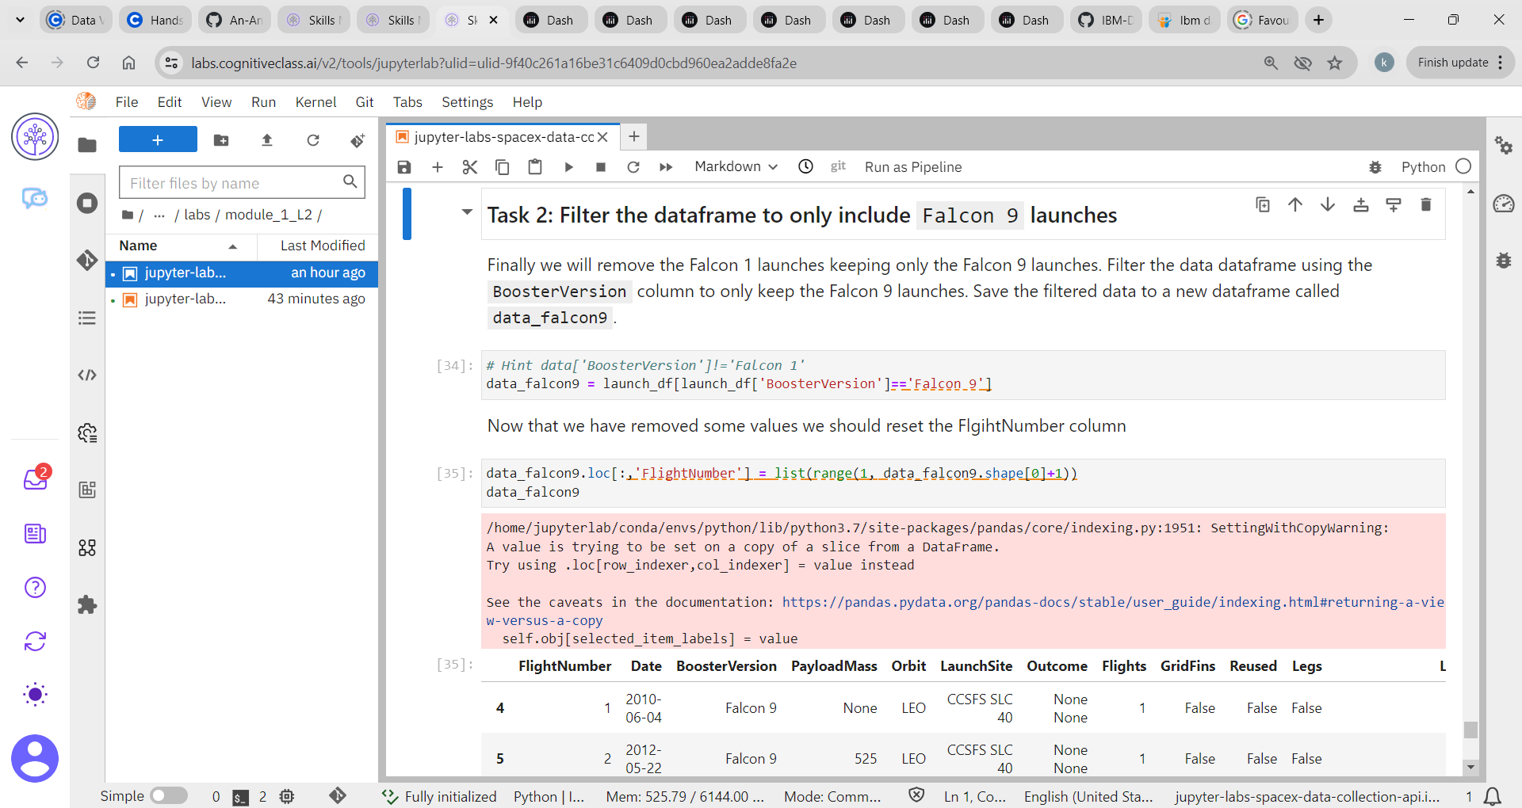
Dataframe only Falcon 9 launches

Slide 10
Data Wrangling
EDA Analysis
Check null values
Calculate the number of launches on each site
Calculate the number and occurrence of each orbit.
Calculate the number and occurrence of mission outcome per orbit type.
Create a landing outcome label from outcome column.
Handle null values

Slide 11
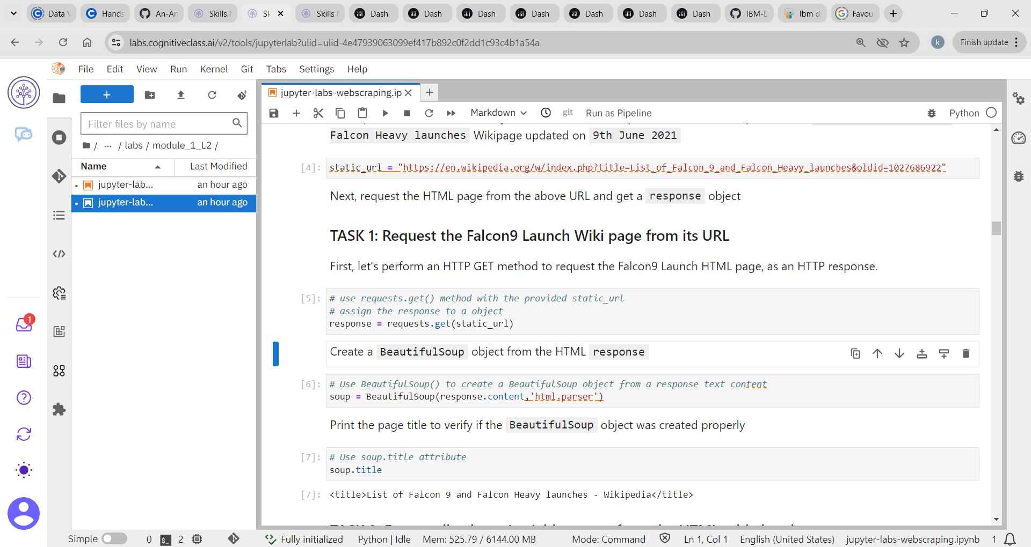
Falcon 9 launch Wiki page from URL

Slide 12
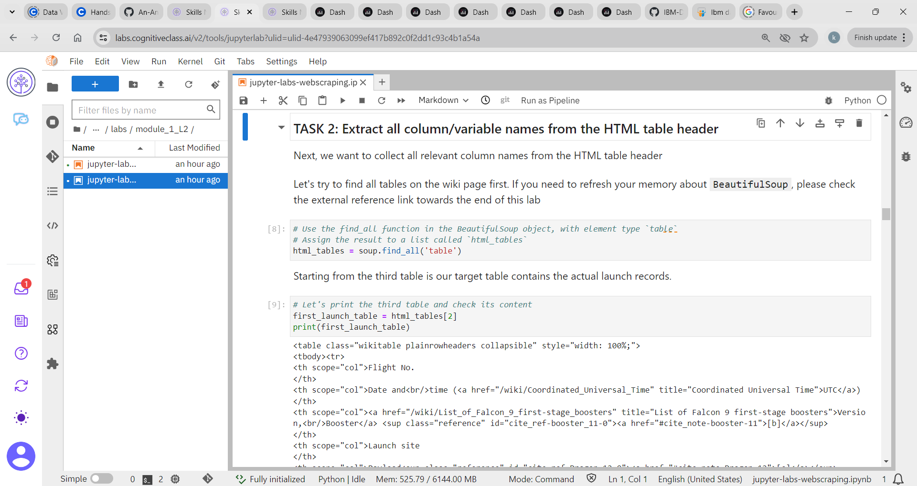
Extract column/variable names from the HTML table

Slide 13
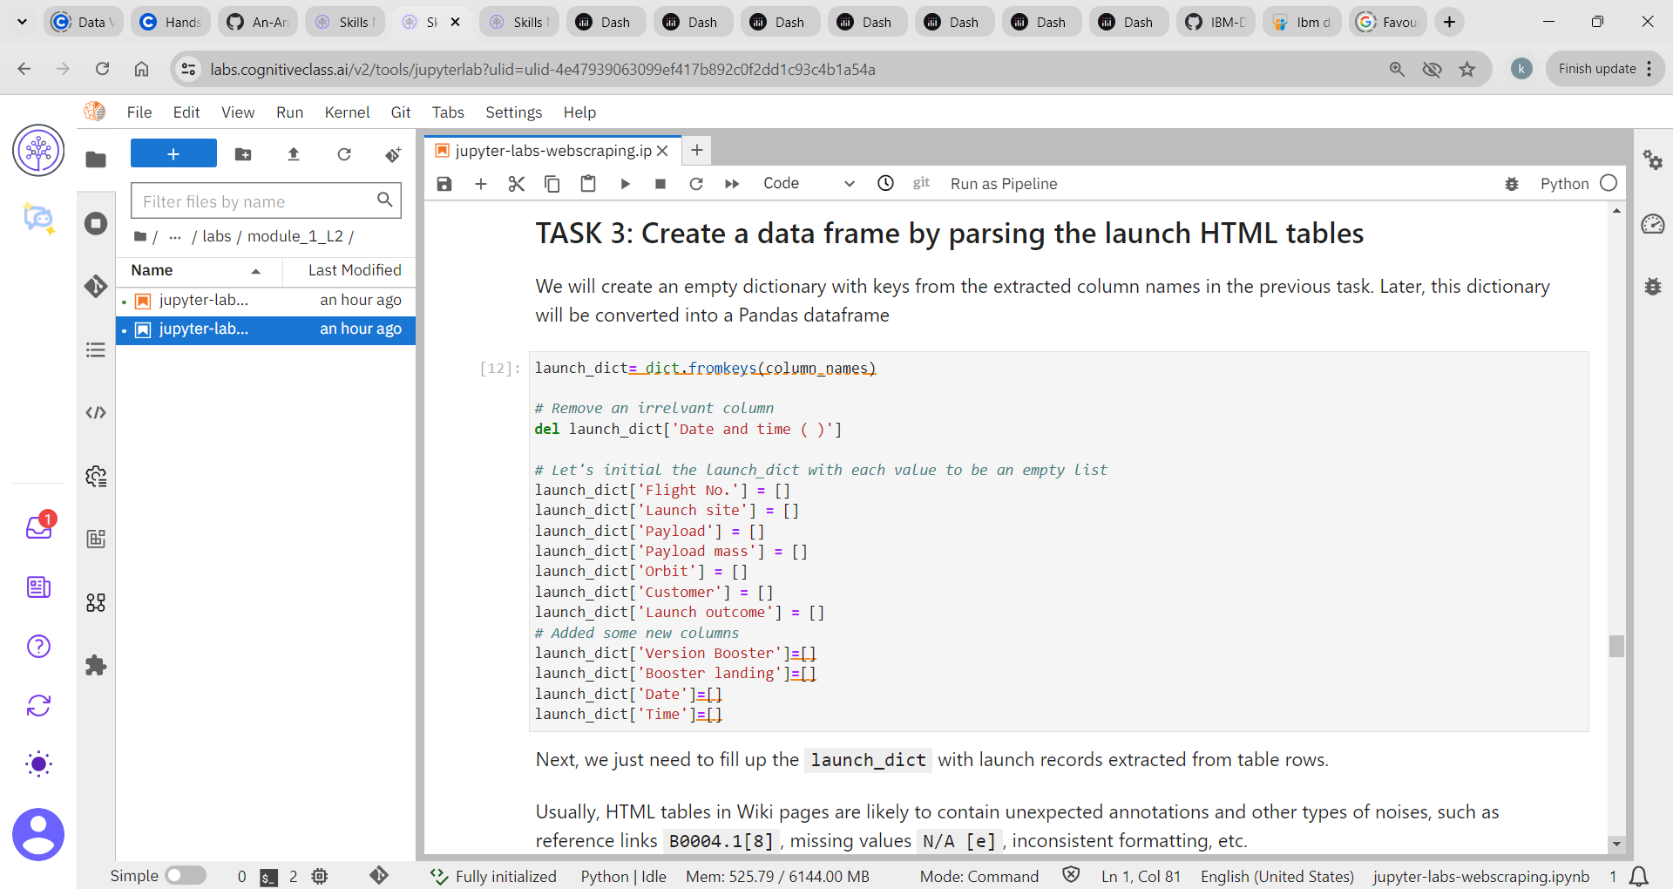
Data frame by parsing the launch HTML tables

Slide 14

Insights drawn from EDA
Section 2

Slide 15
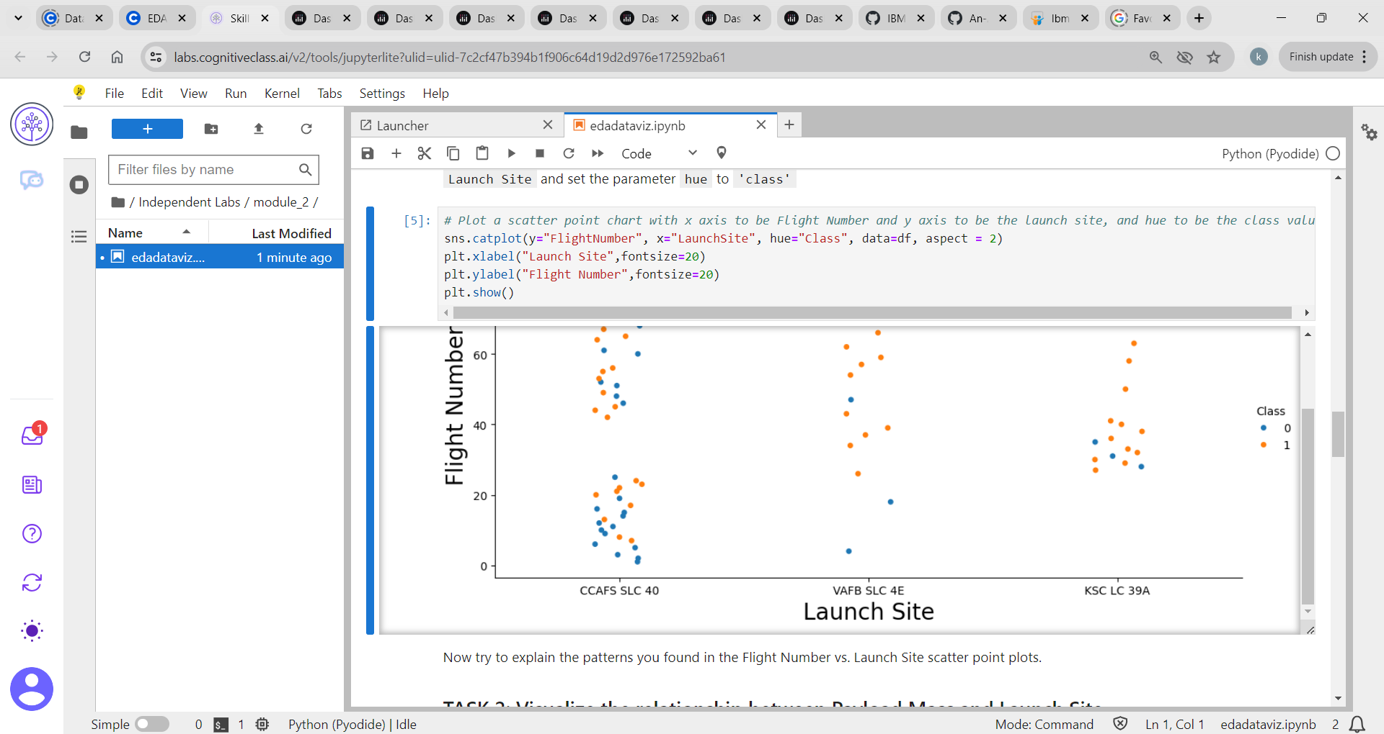
Flight number vs Launch site

Slide 16
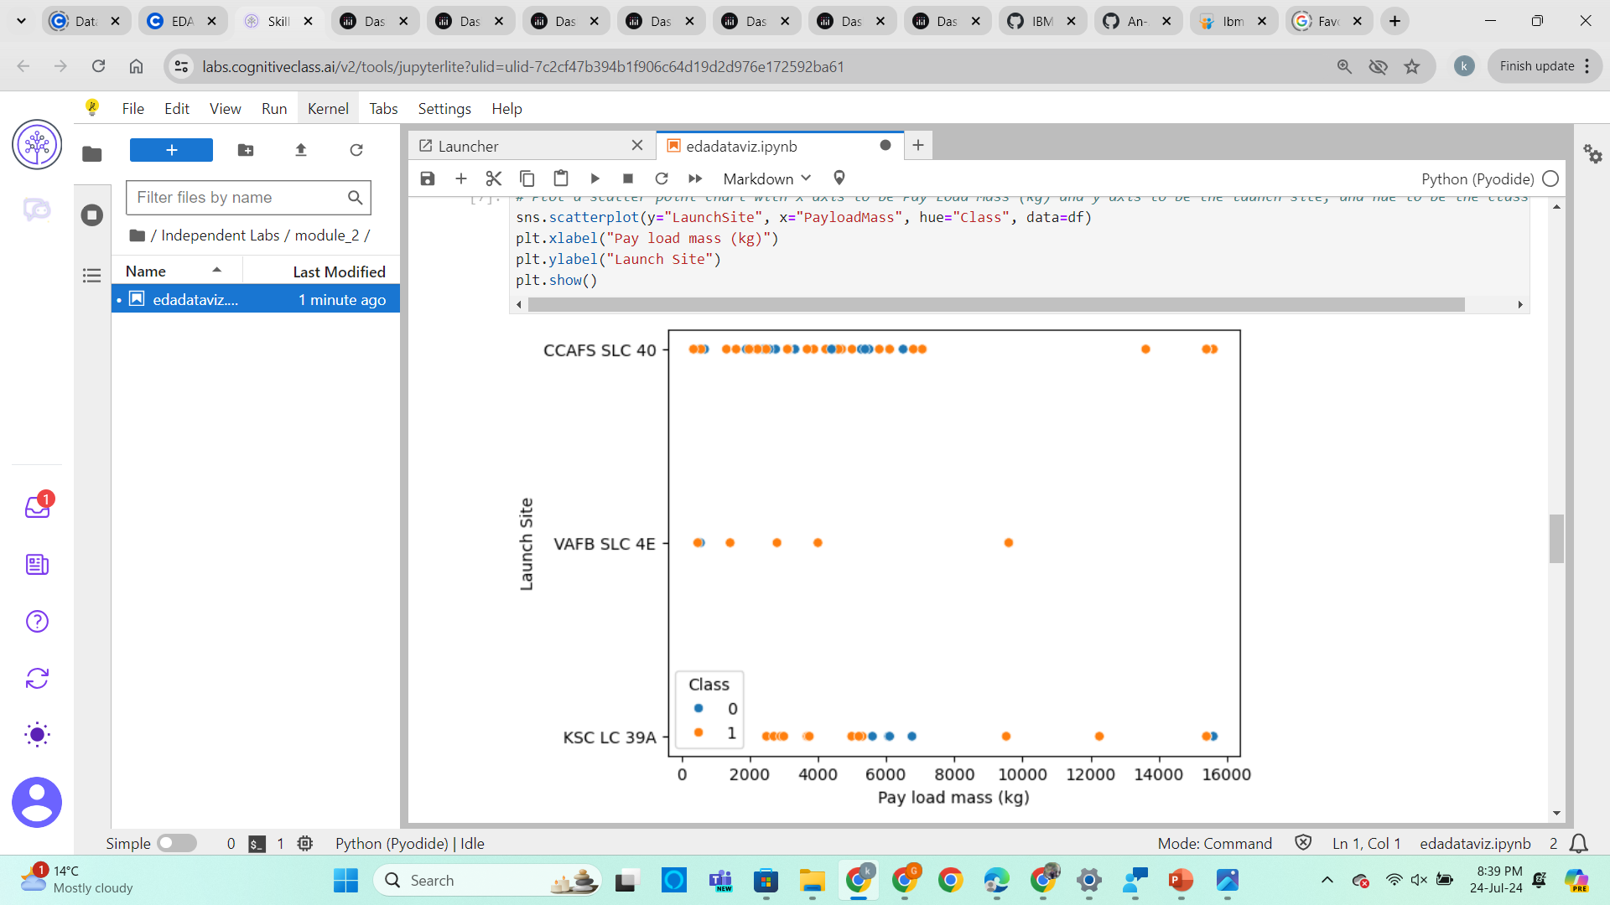
Launch site vs Payload mass

Slide 17
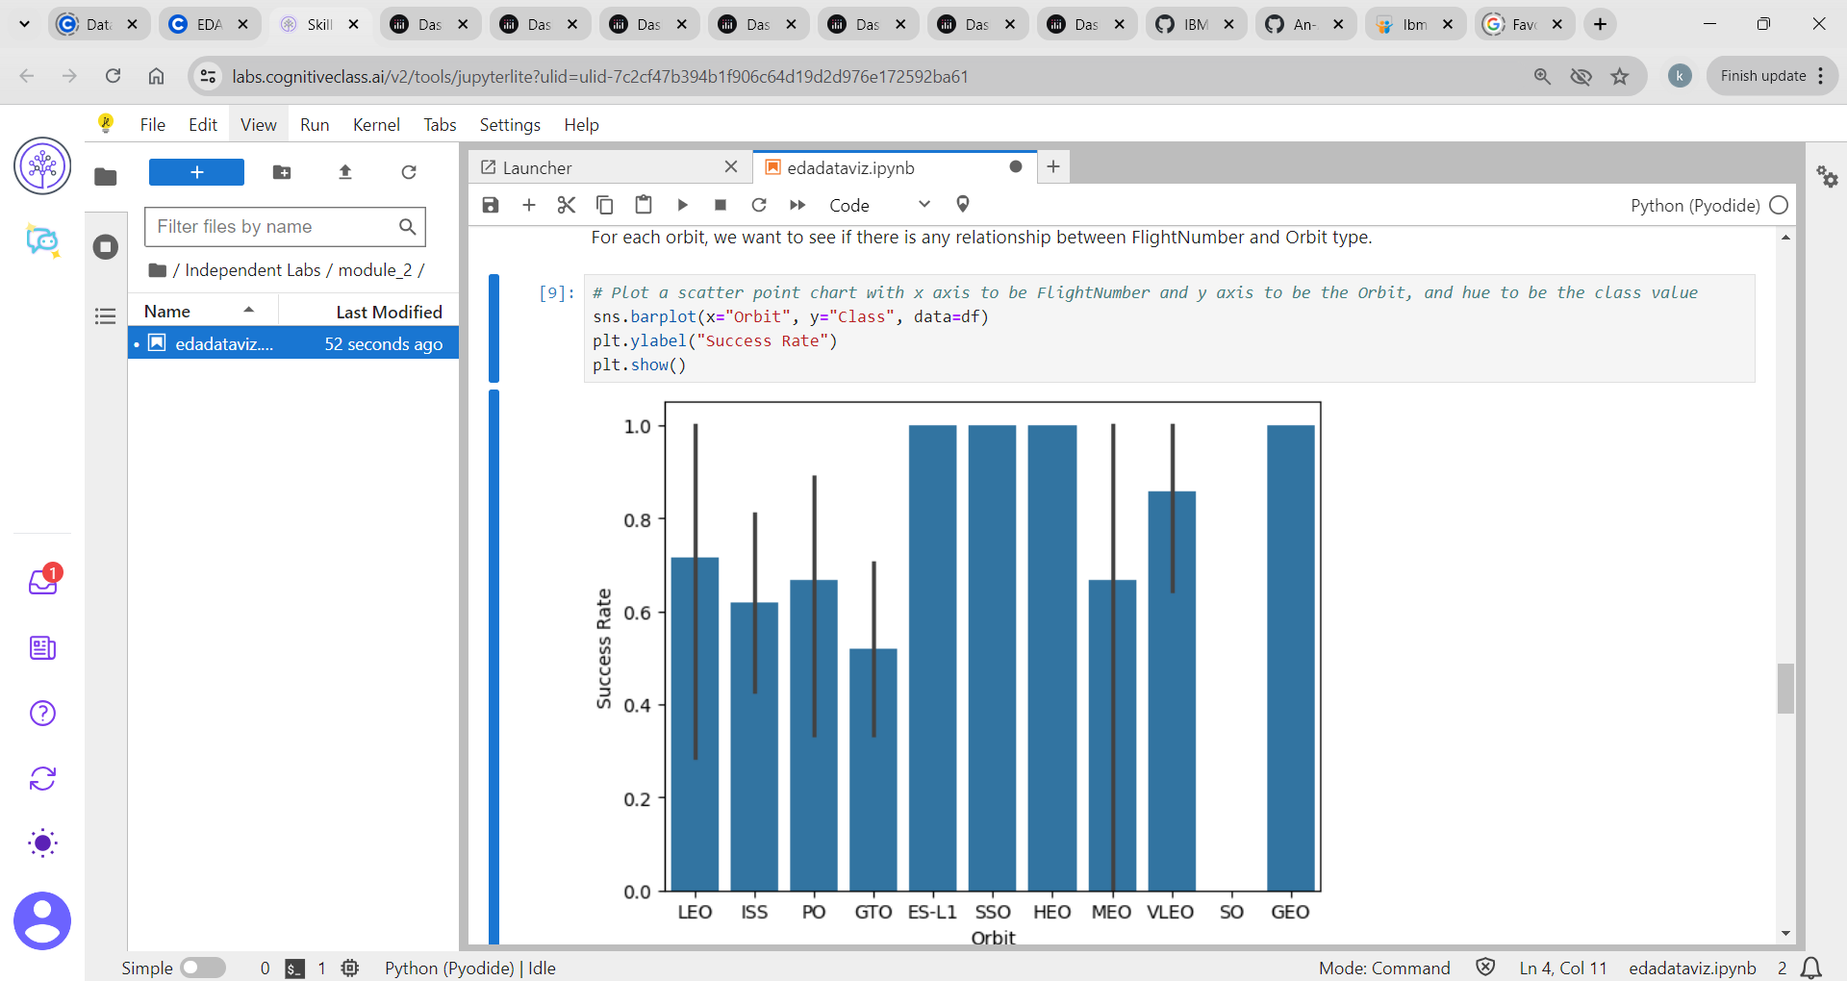
Success rate vs Orbit type

Slide 18
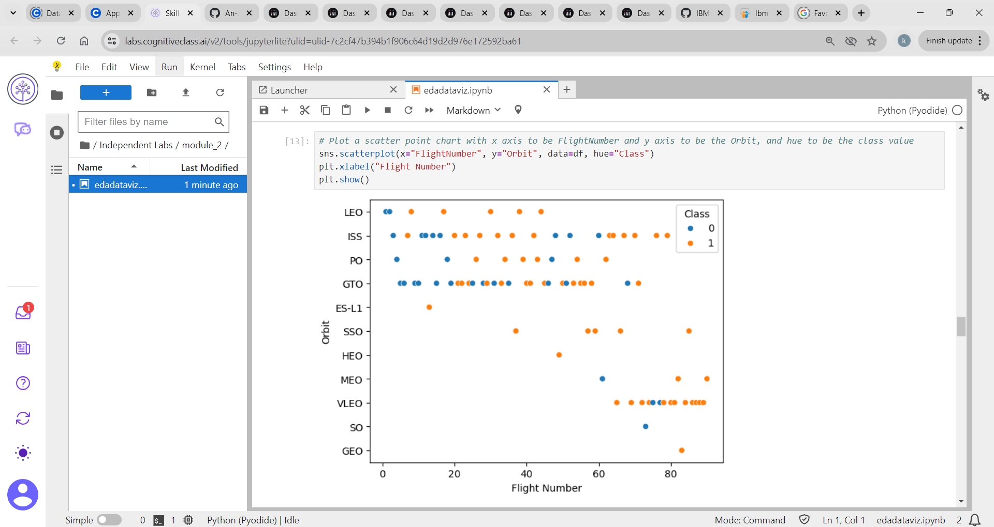
Flight number vs Orbit type

Slide 19
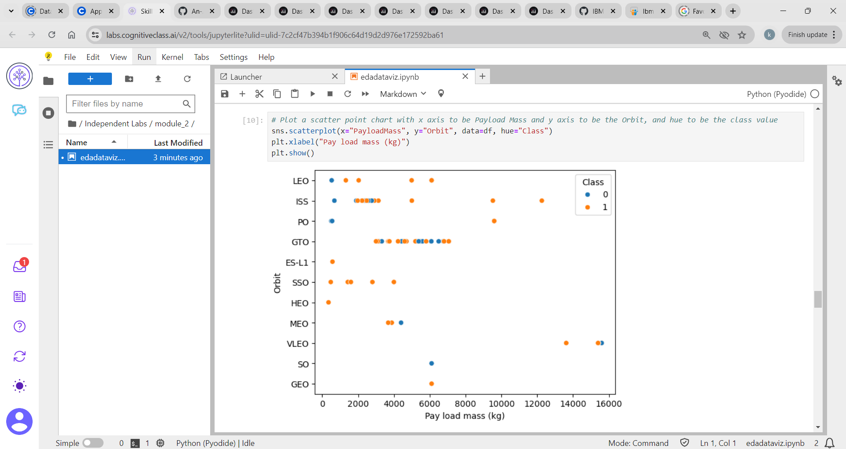
Payload mass vs Orbit type

Slide 20
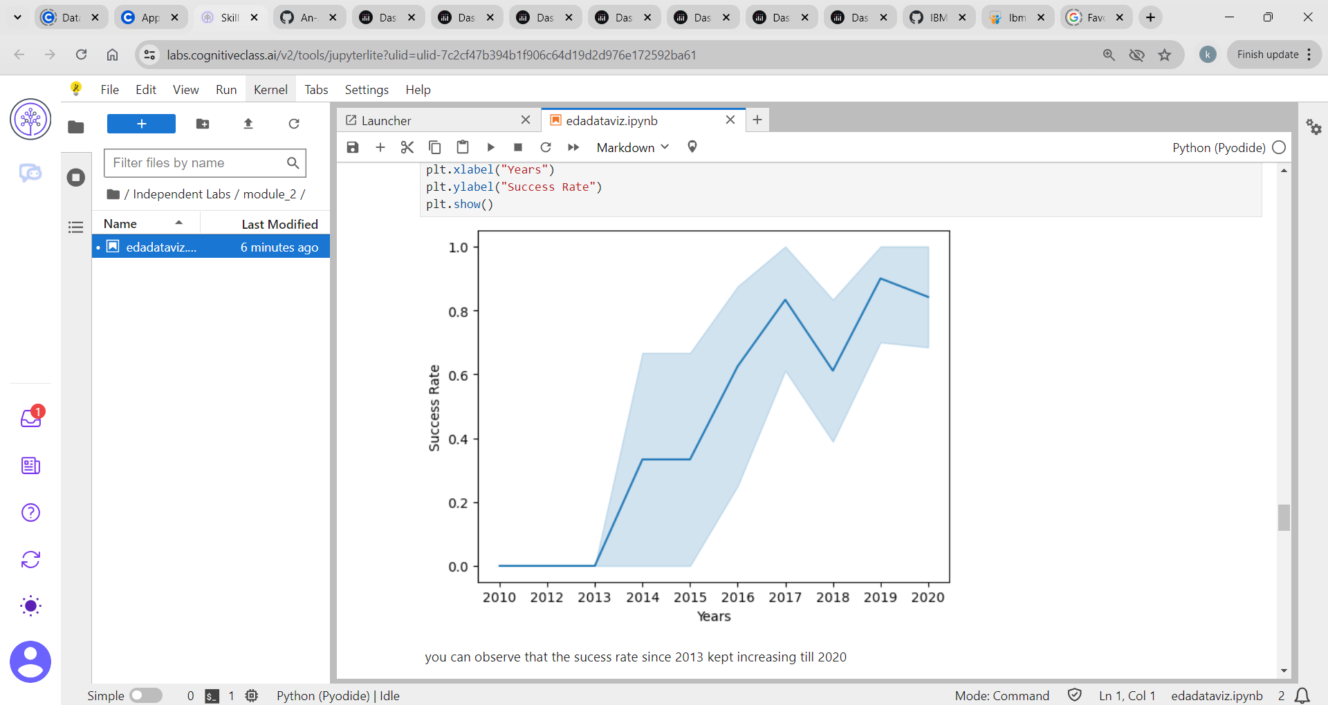
Launch Success Yearly Trend

Slide 21
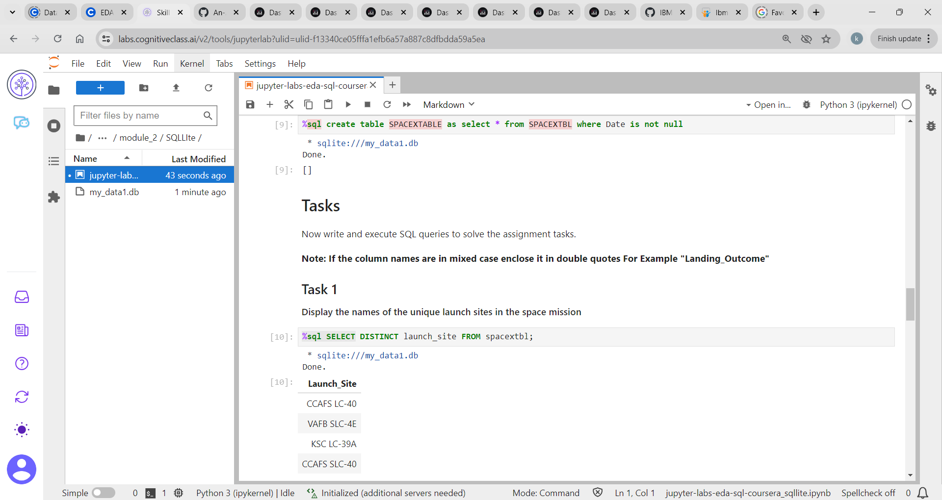
All launch site names

Slide 22
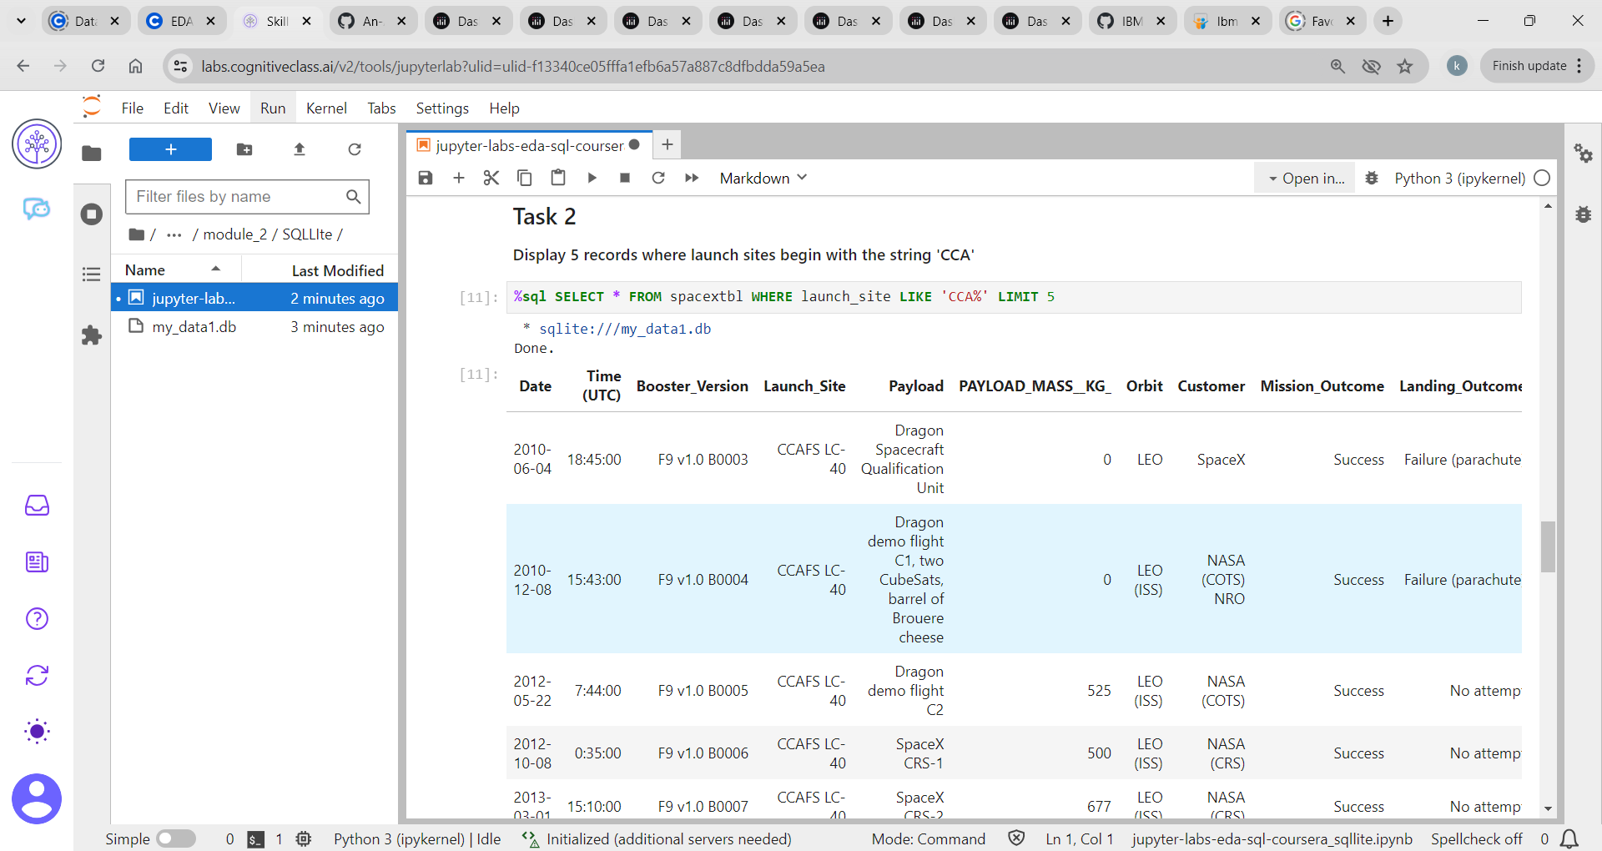
Launch site names begin with “CCA”

Slide 23
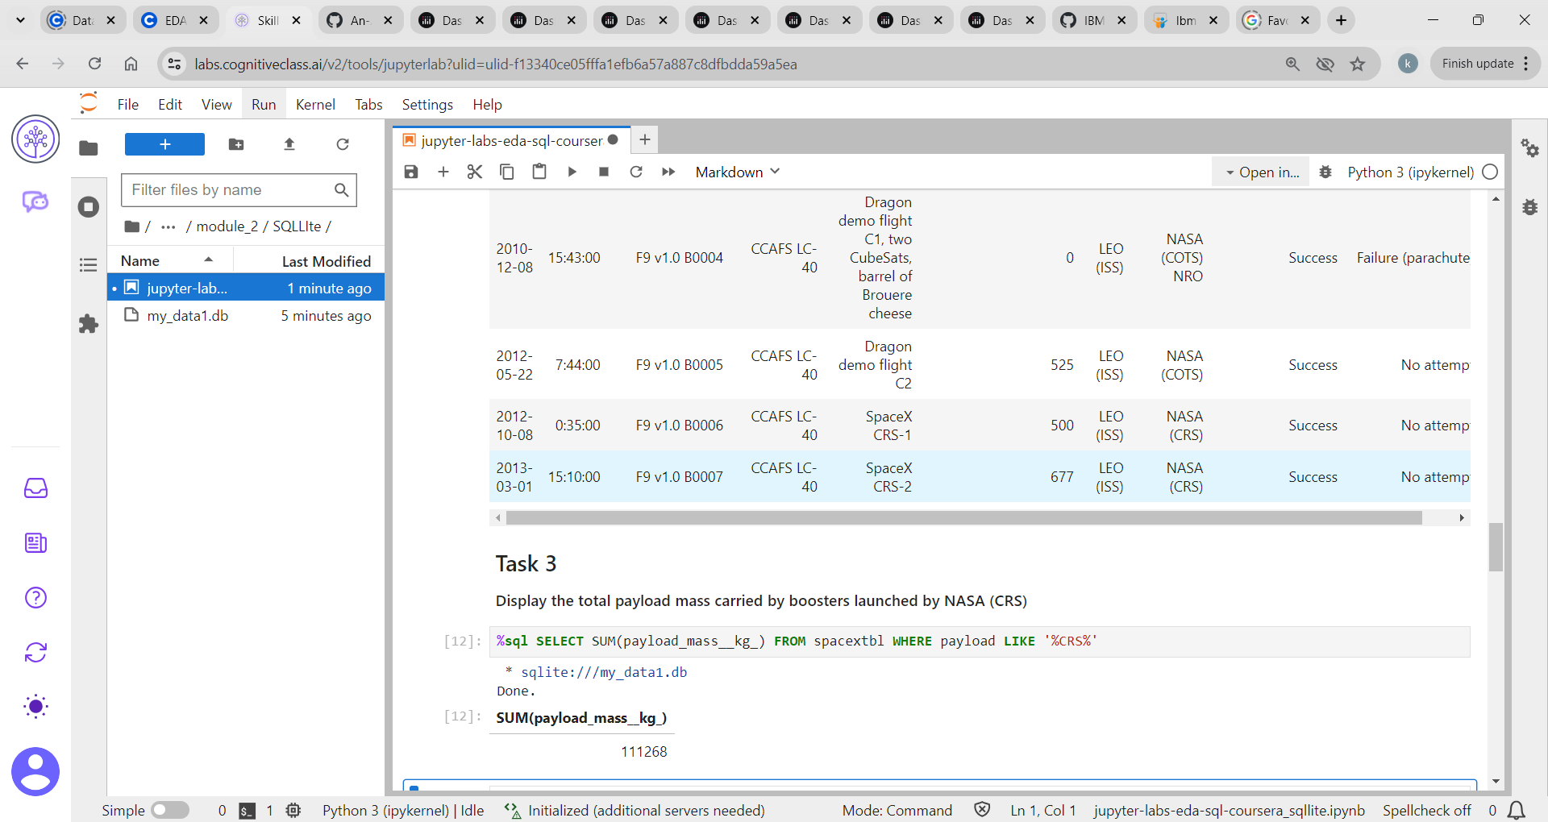
Total Payload mass = 111268

Slide 24
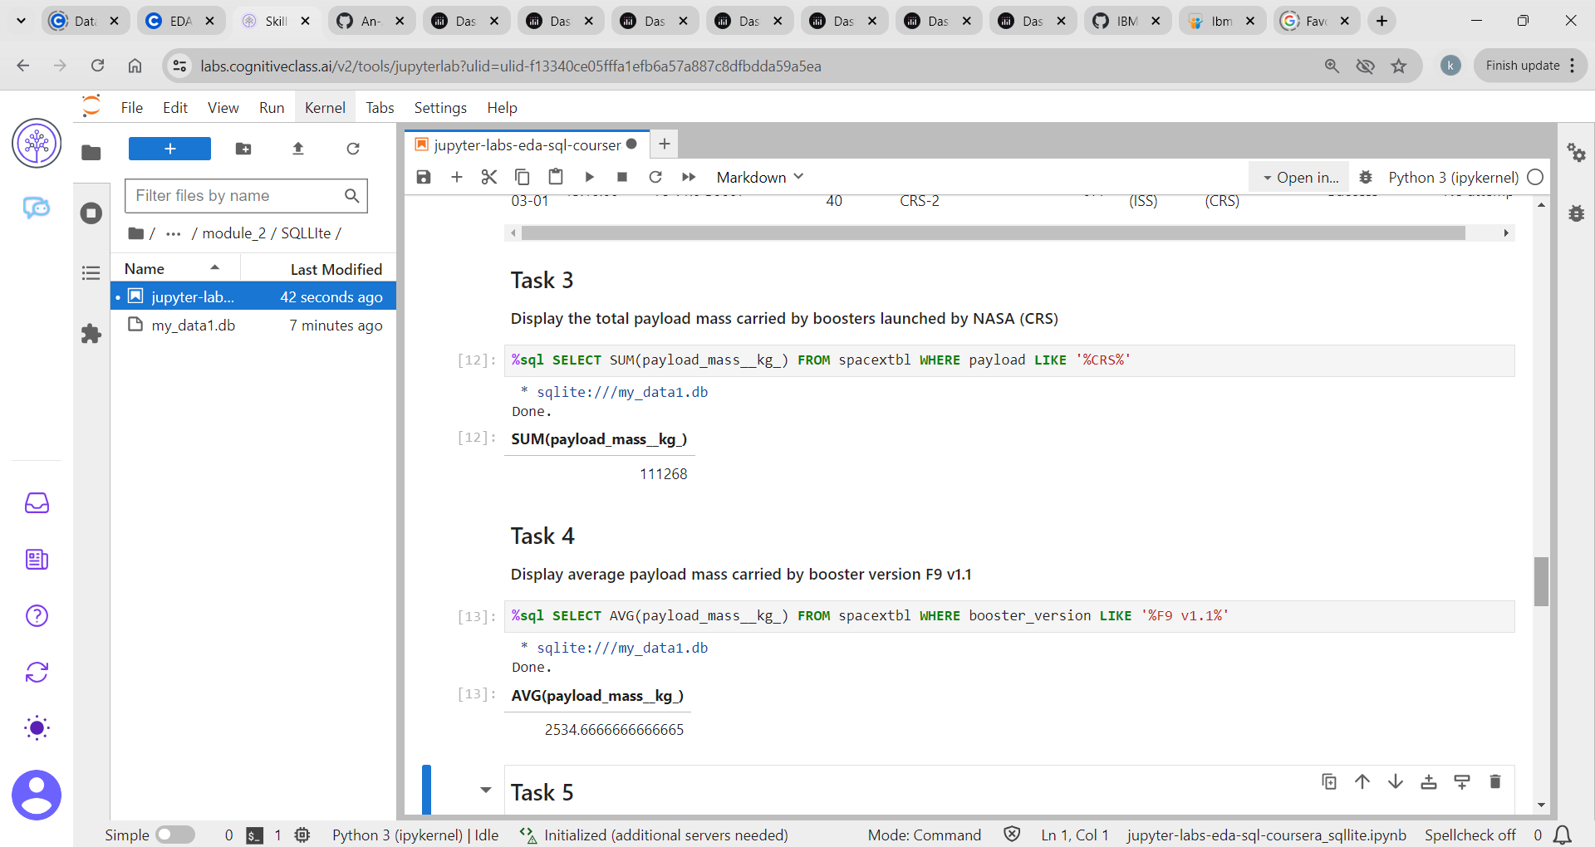
Average Payload mass carried by booster version F9 v1.1 = 2534.6666

Slide 25
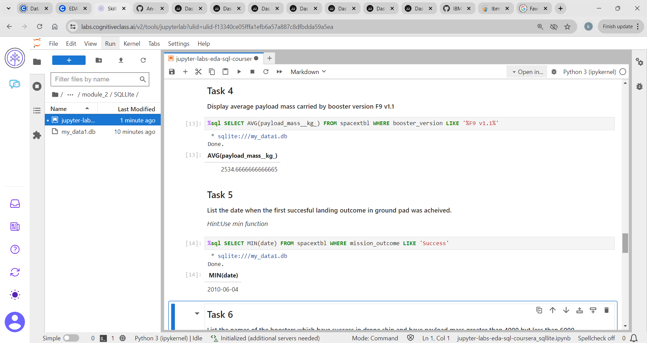
First successful ground landing outcome = 2010-06-04

Slide 26
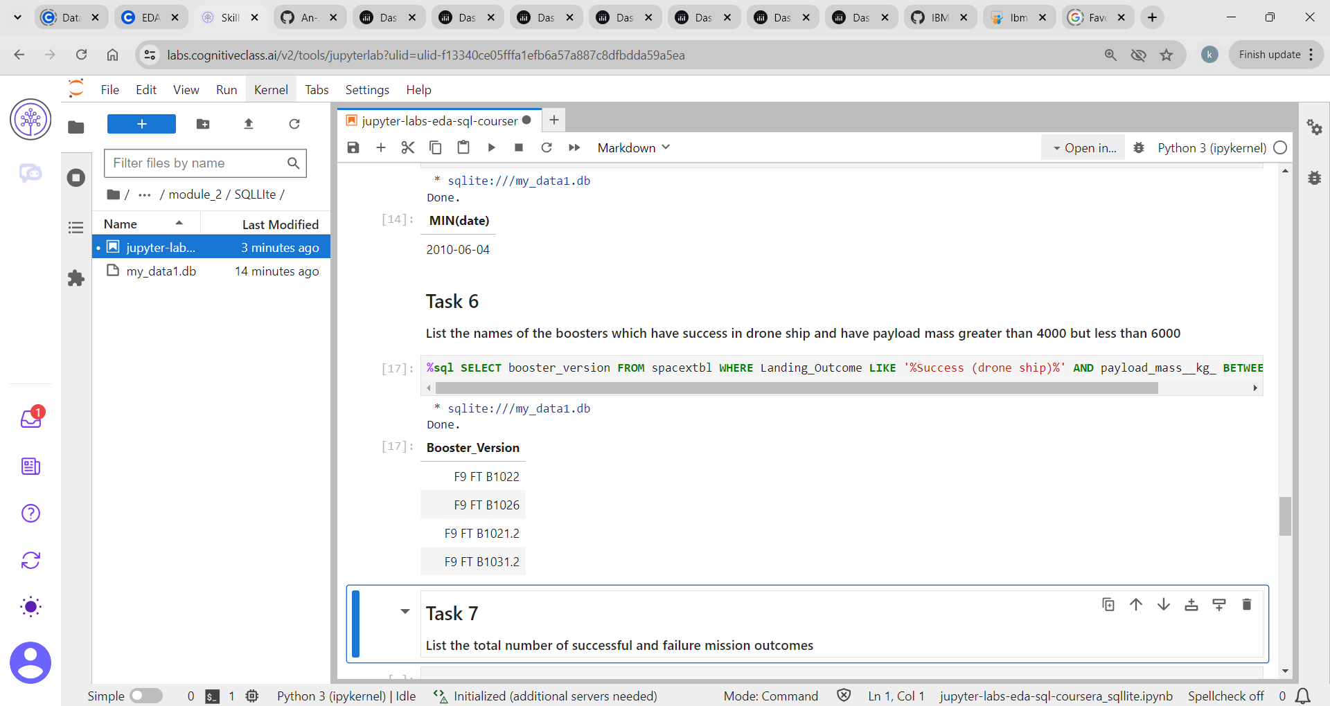
Successful Drone ship landing between 4000 and 6000

Slide 27
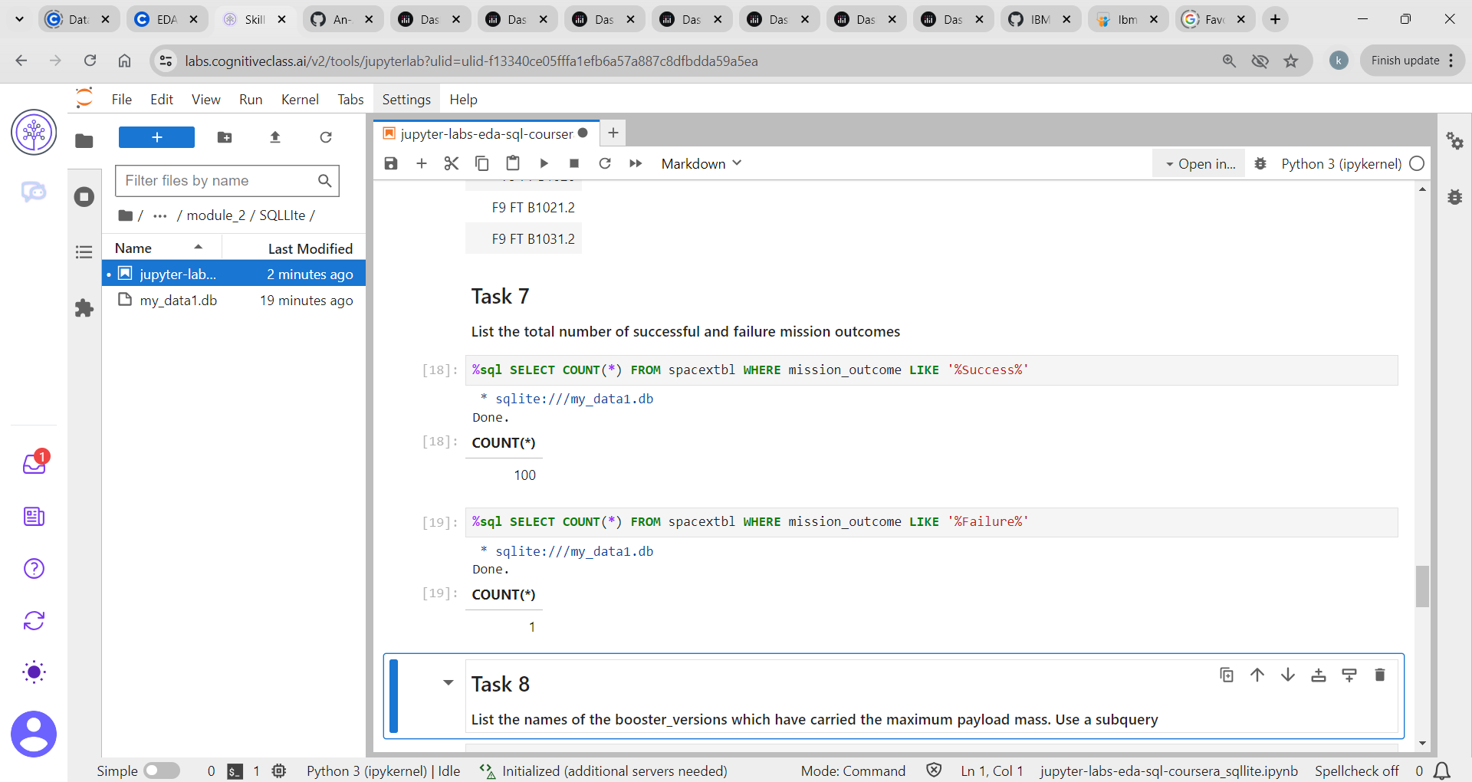
Total number of successful and failure mission outcomes

Slide 28
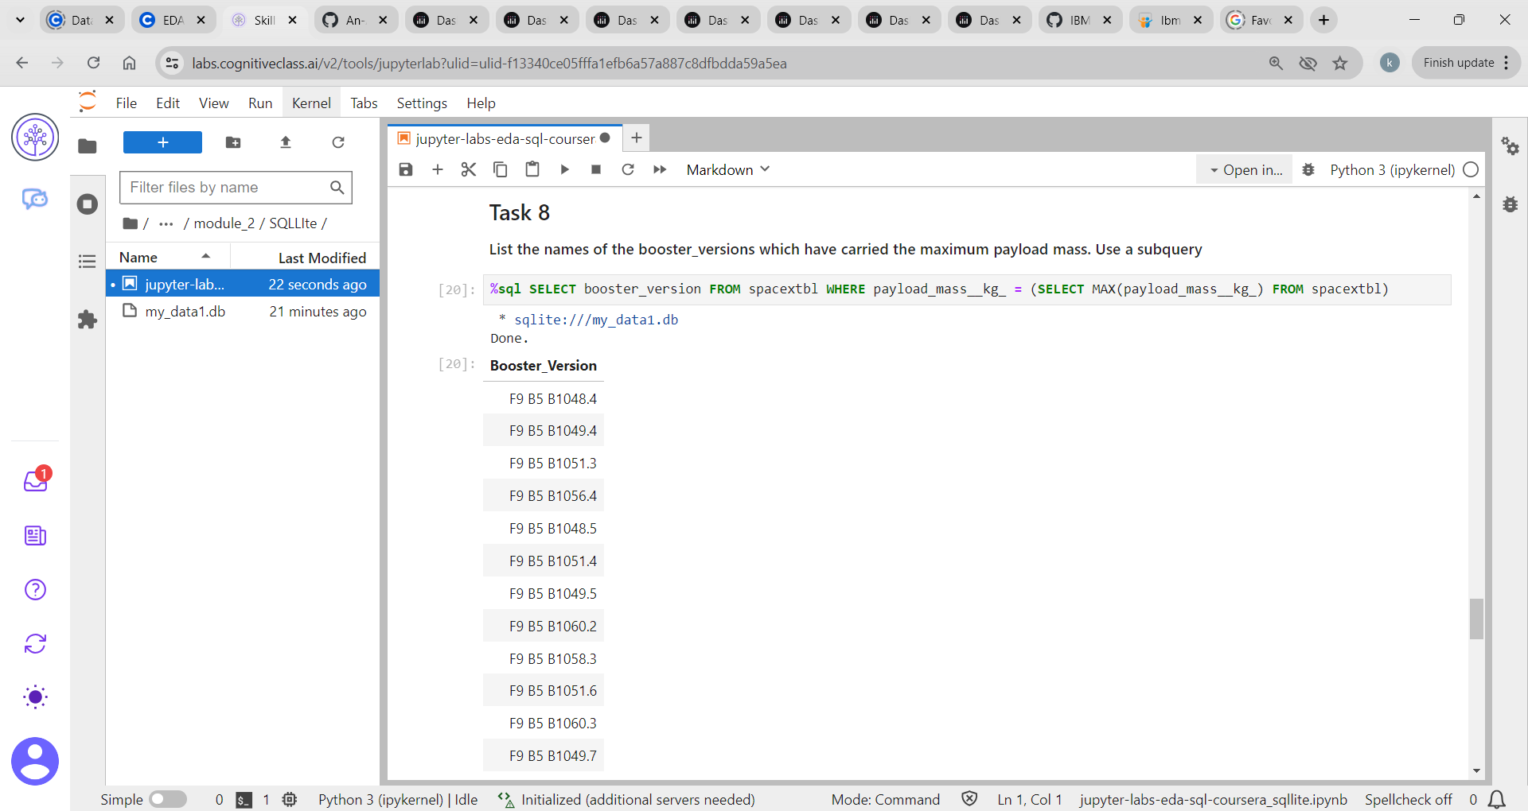
Boosters carry maximum Payload

Slide 29
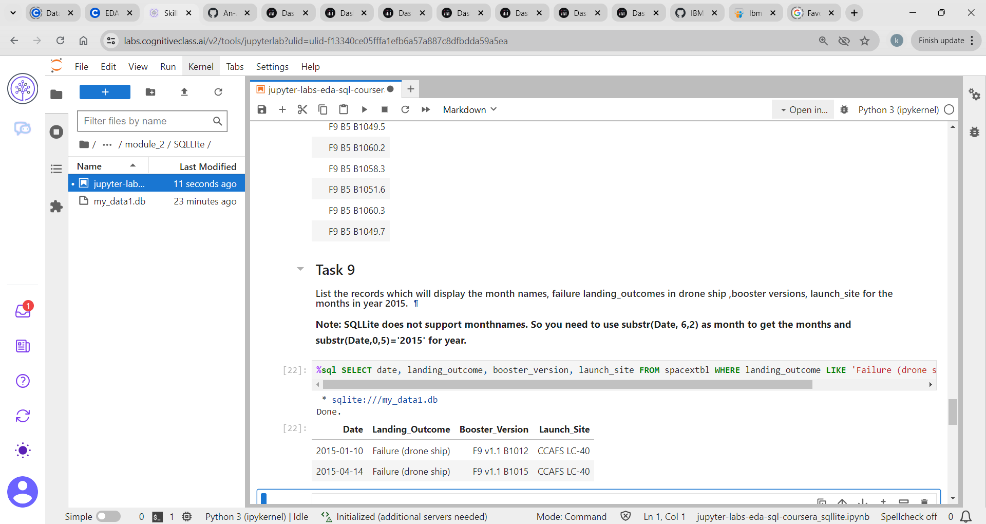
2015 Launch Records

Slide 30
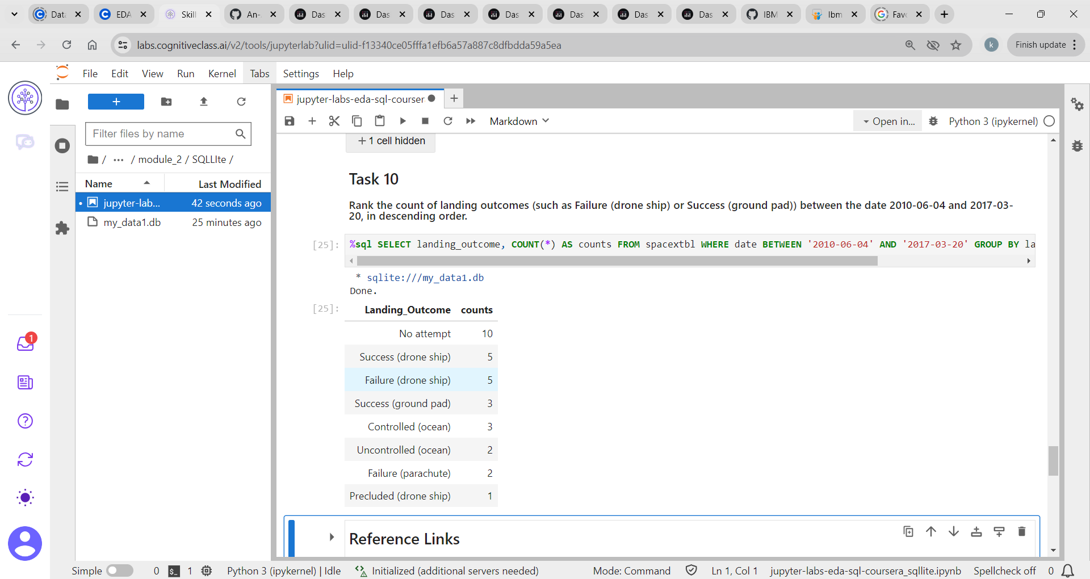
Landing outcomes (such as failure or success) between 2010 & 2017

Slide 31

Launch Sites Proximities Analysis
Section 3

Slide 32
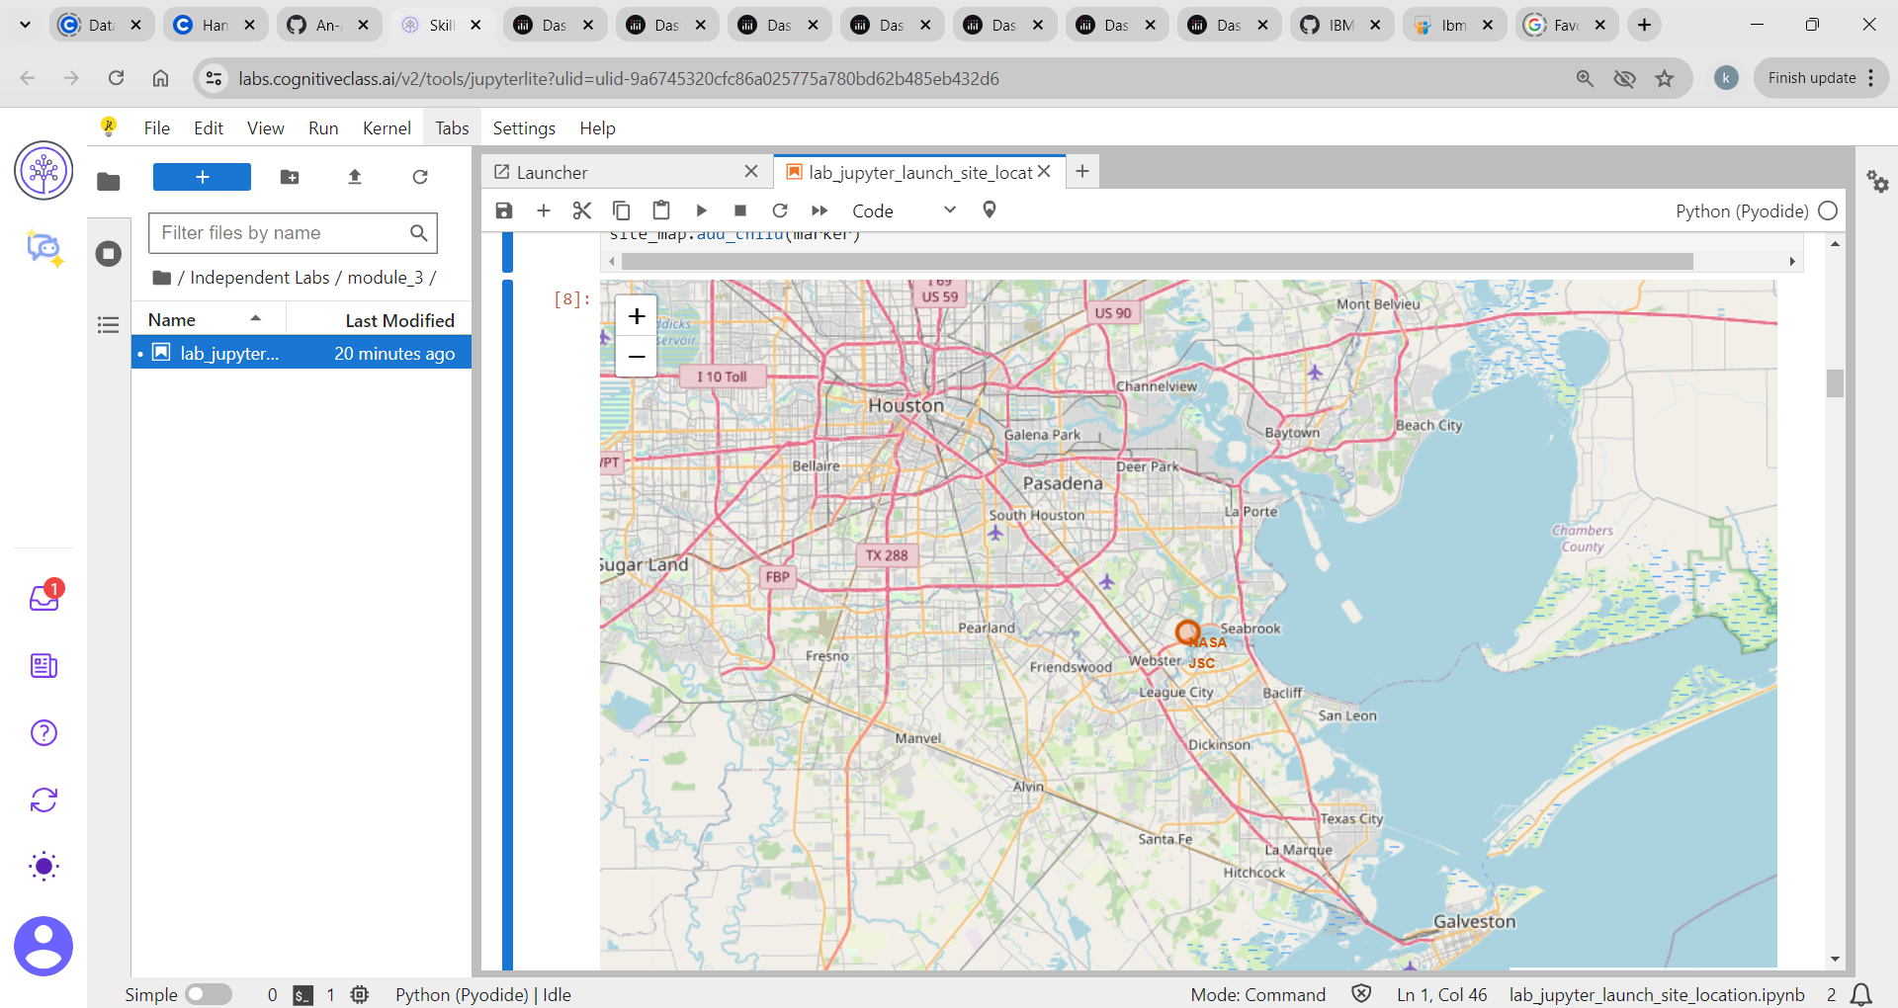
All launch sites marked on a Map

Slide 33
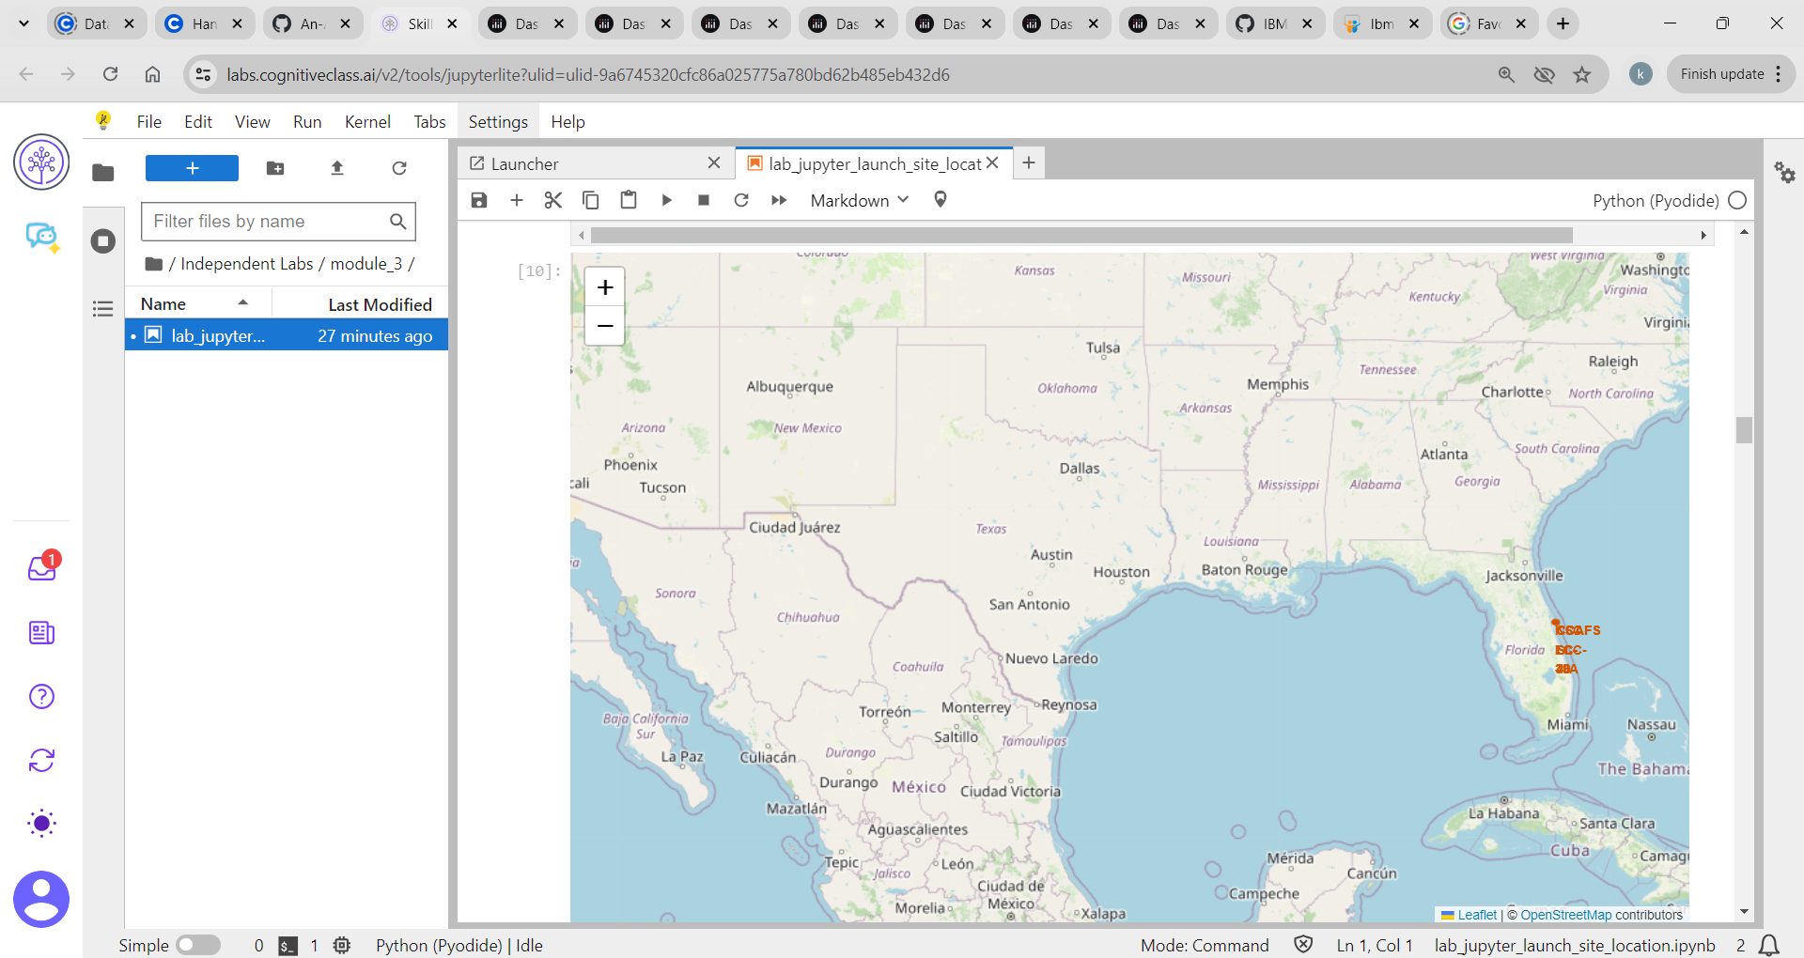
Success / failure launches marked on the map

Slide 34
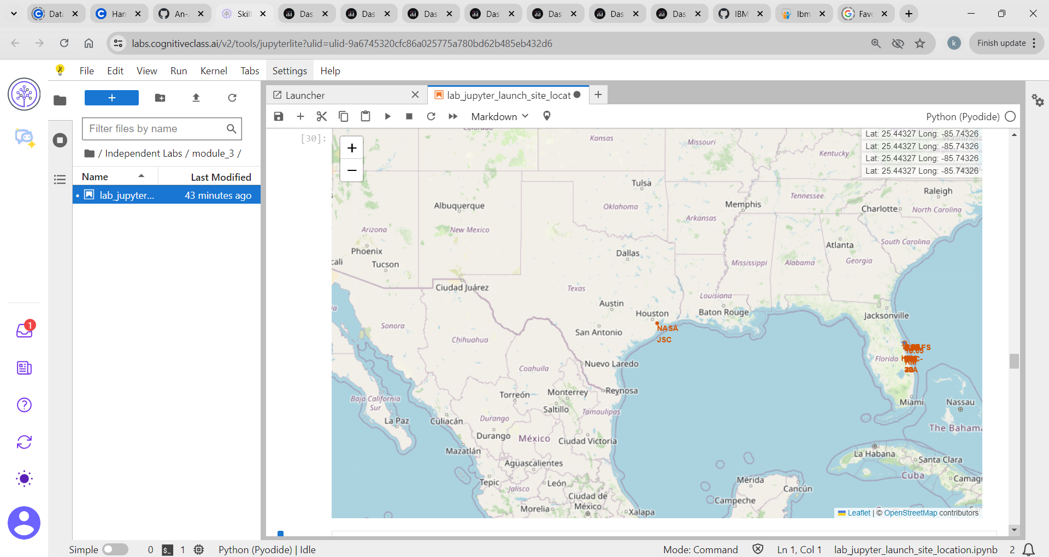
Distances between a launch site to its Proximities

Slide 35
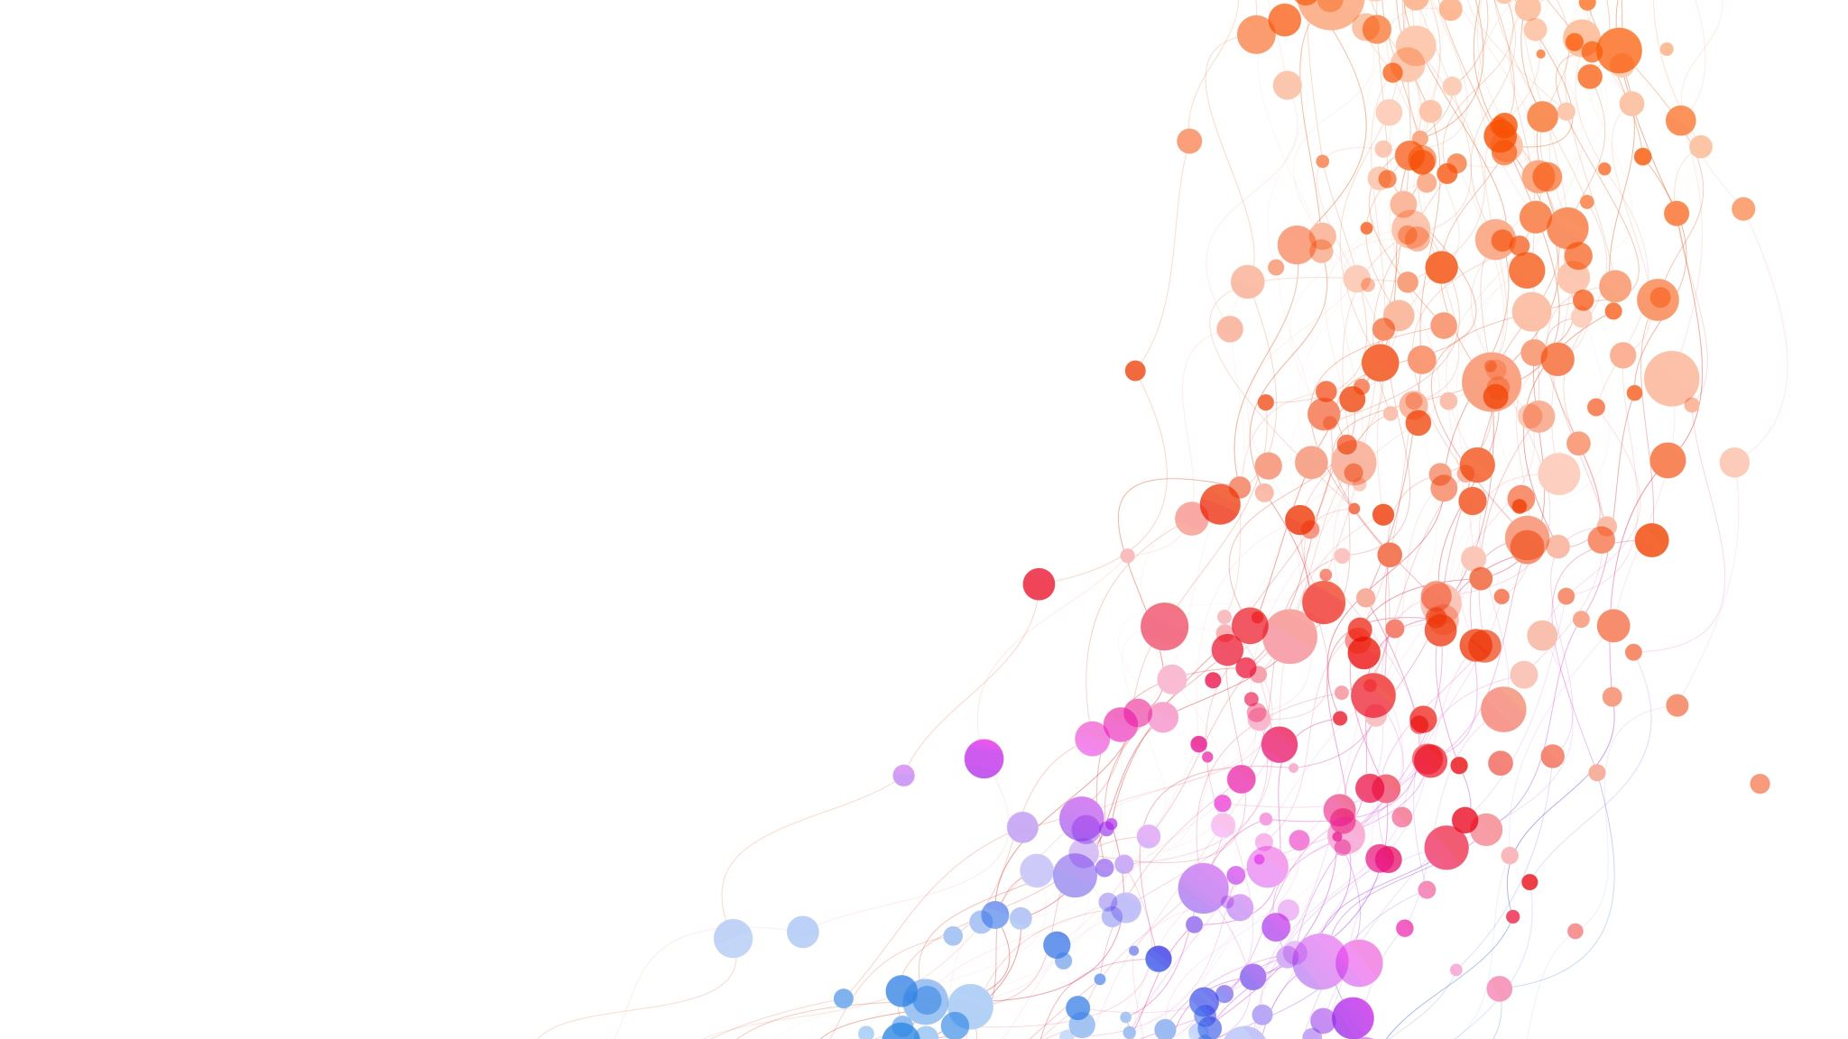
Build a Dashboard with Plotly Dash
Section 4

Slide 36
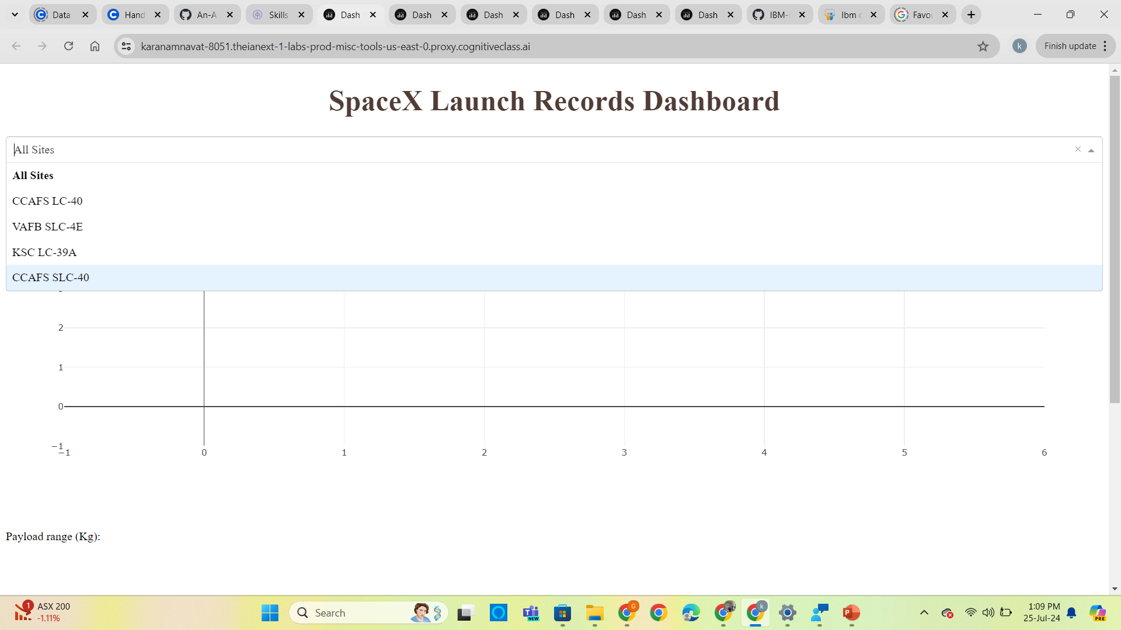
Launch Site drop down Input Component

Slide 37
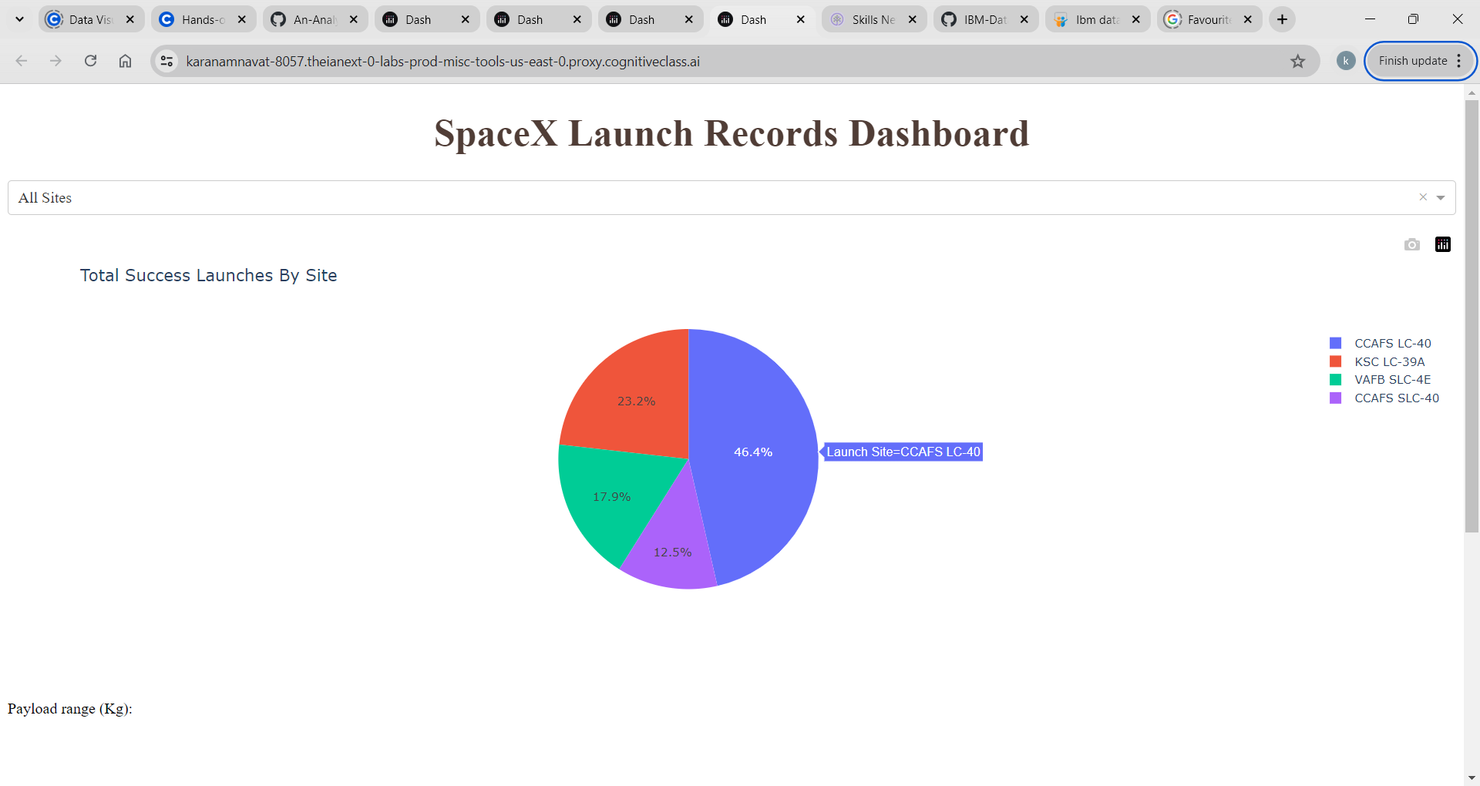
Pie chart for all sites selected

Slide 38
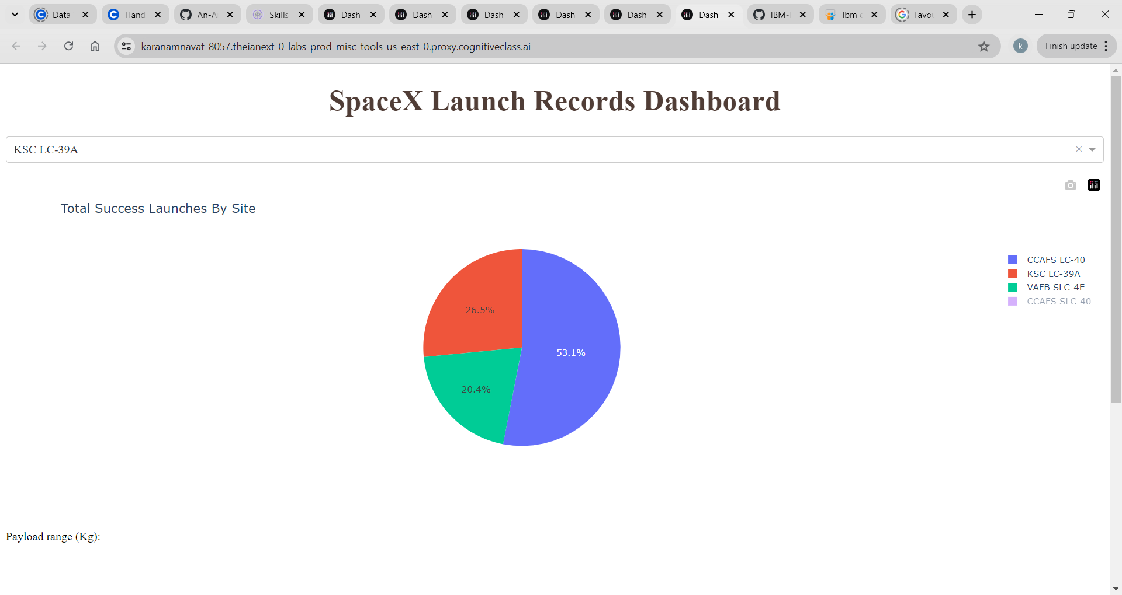
Pie chart for is selected

Slide 39
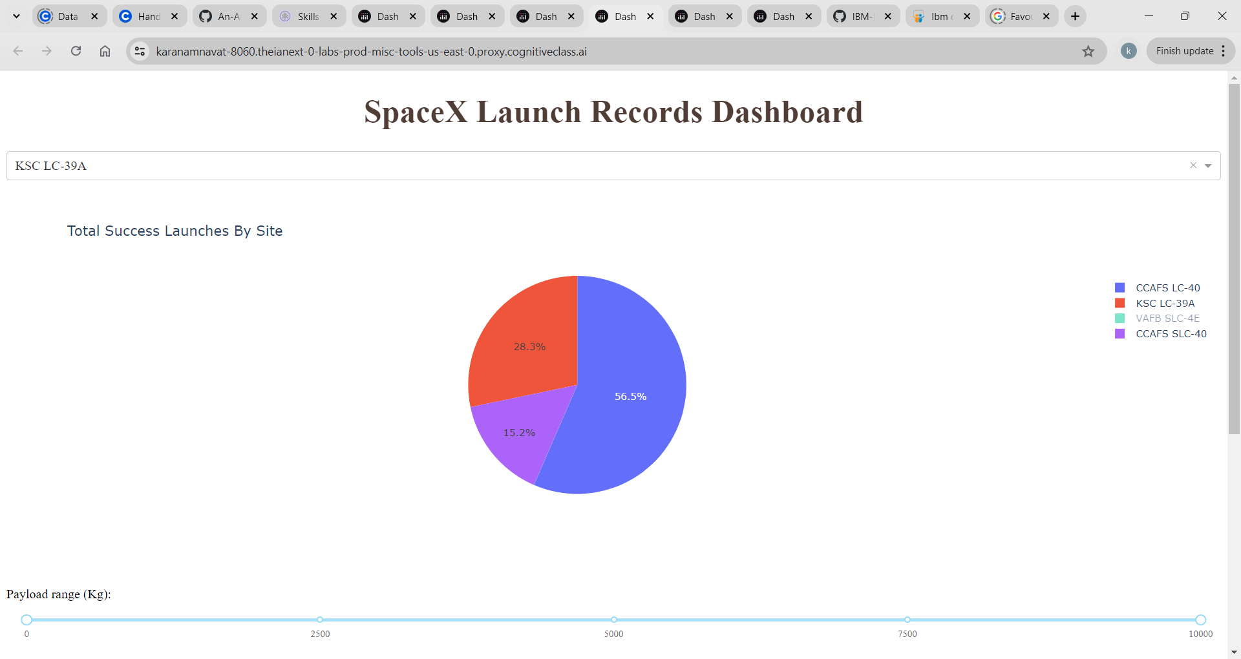
Range Slider to select Payload

Slide 40
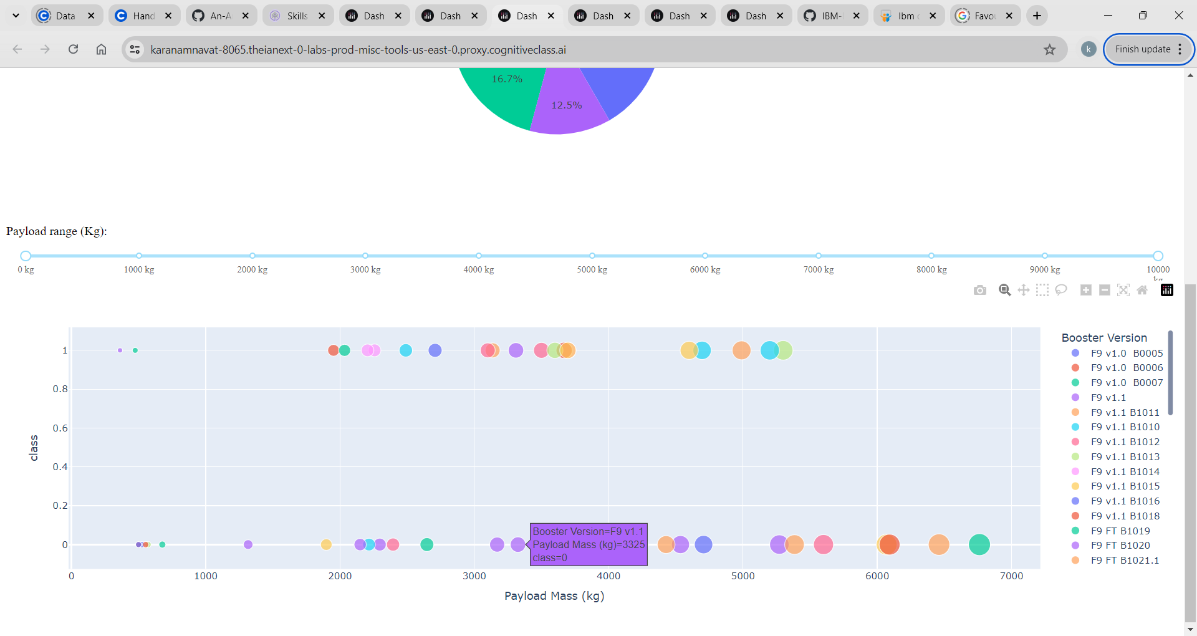
Callback function to render a Scatter Plot

Slide 41

Predictive Analysis (Classification)
Section 5

Slide 42
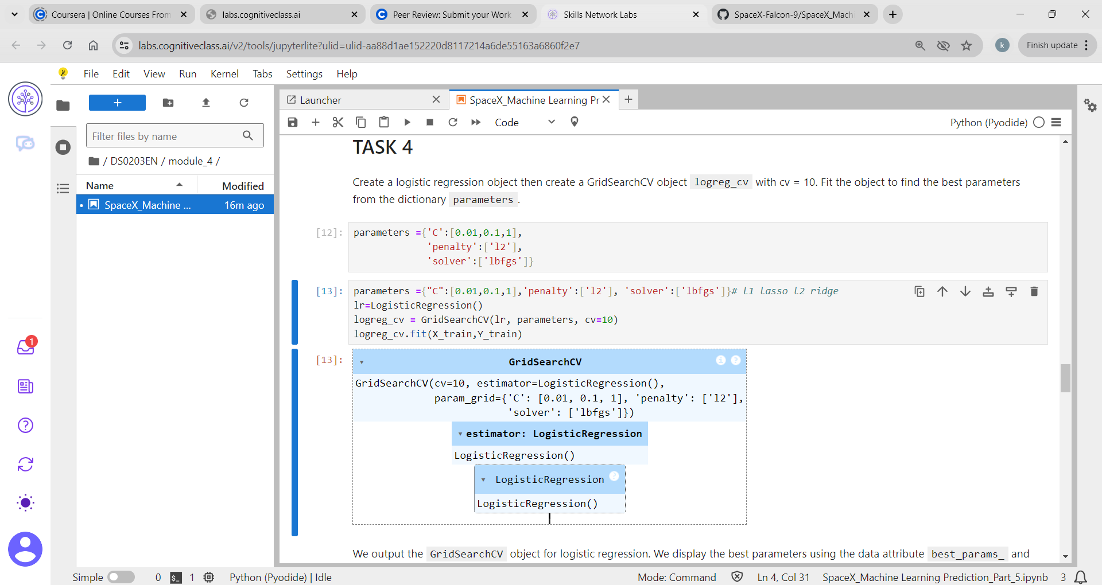
Logistic Regression

Slide 43
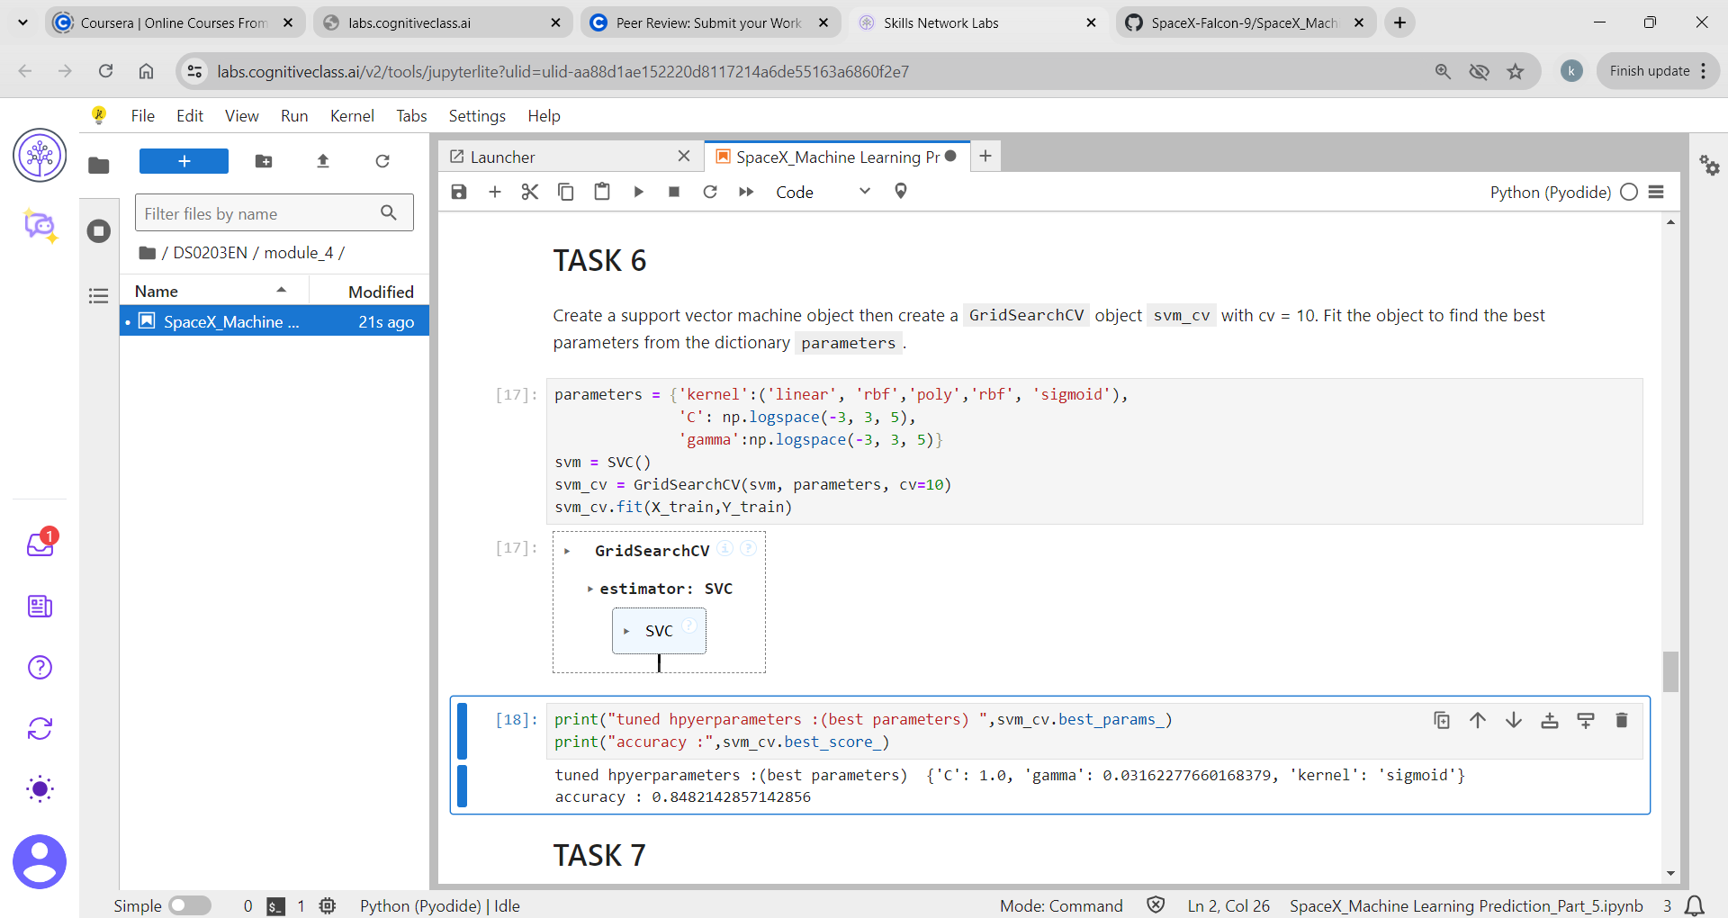
Support Vector Machine

Slide 44
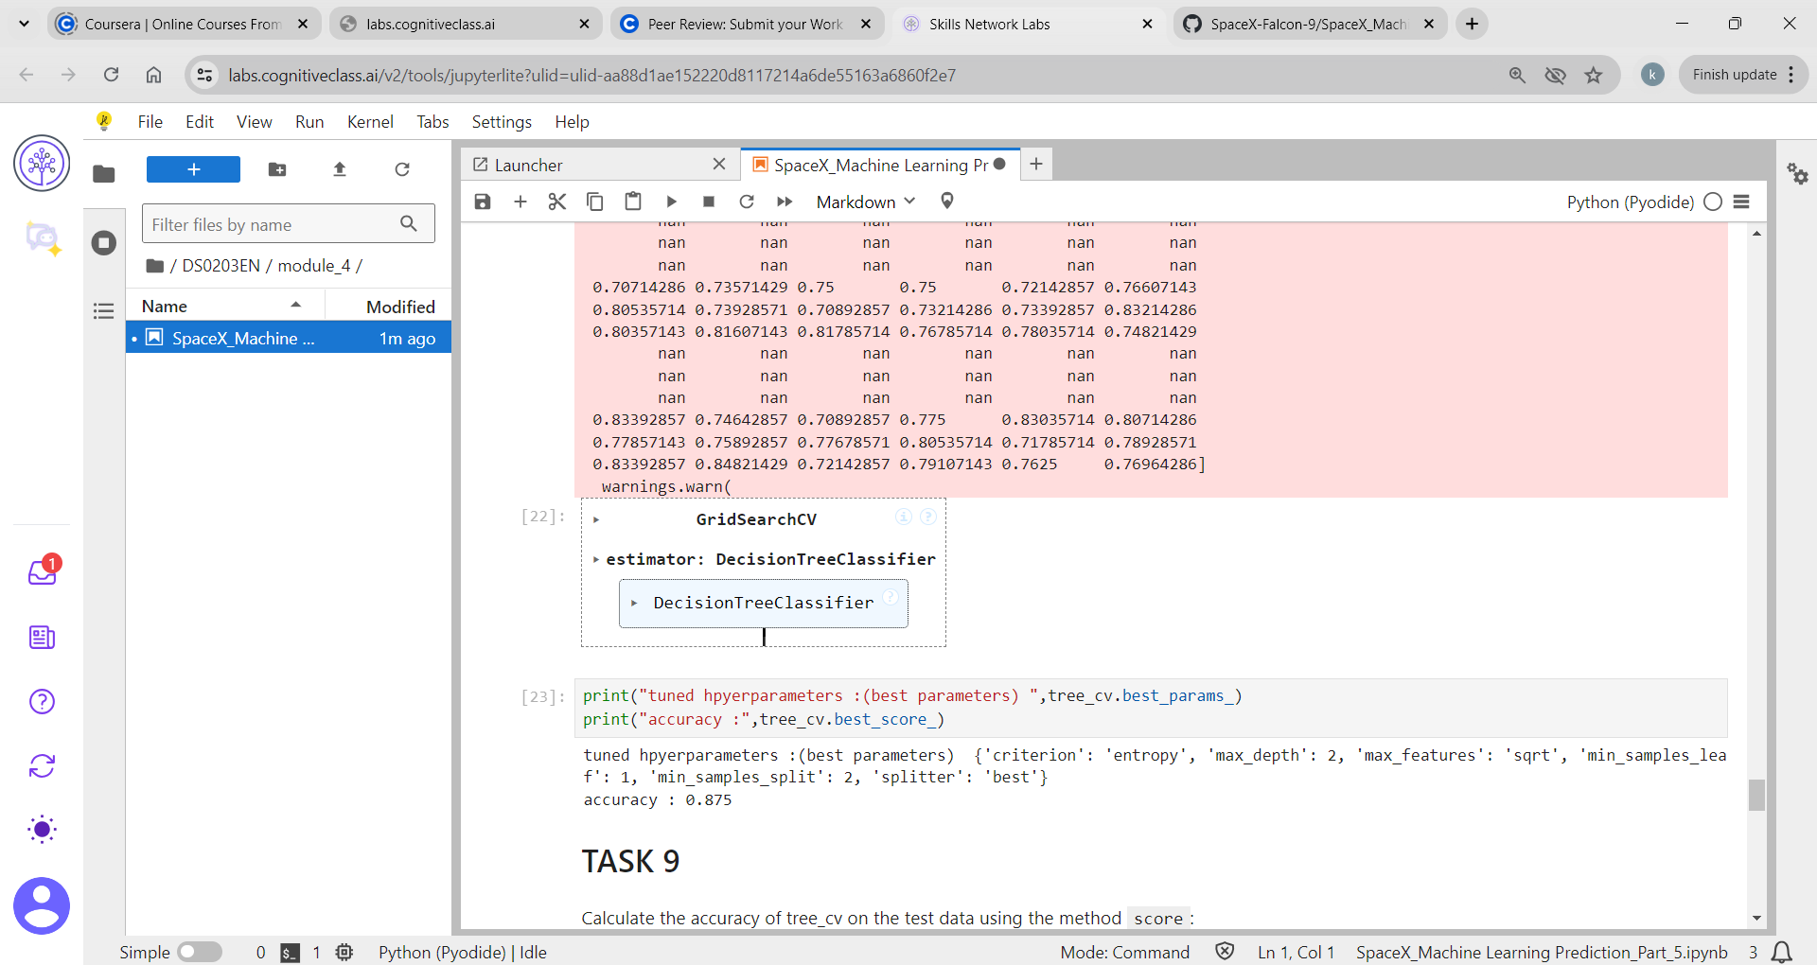
Decision Tree Classifier

Slide 45
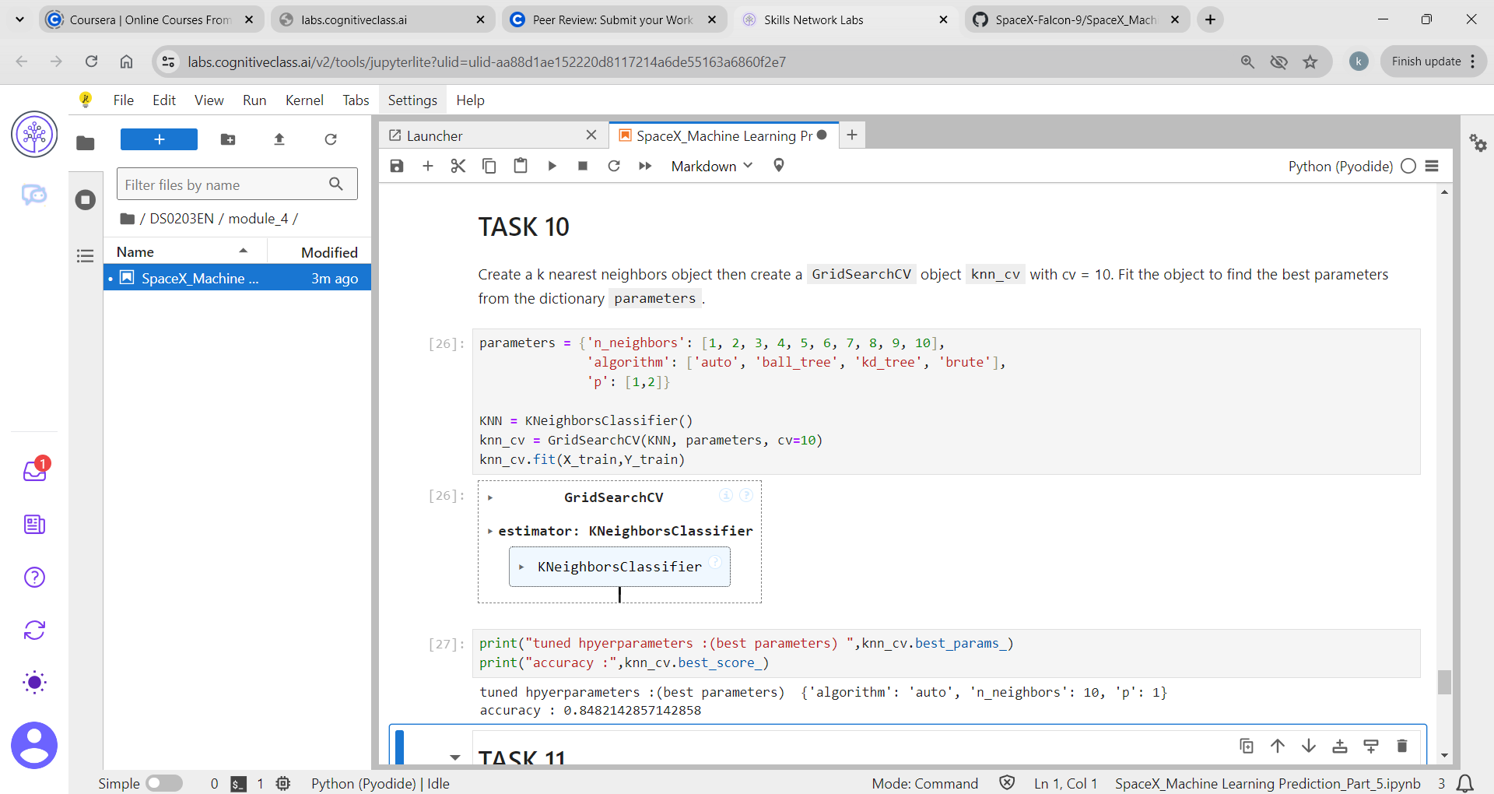
K Nearest Neighbour

Slide 46
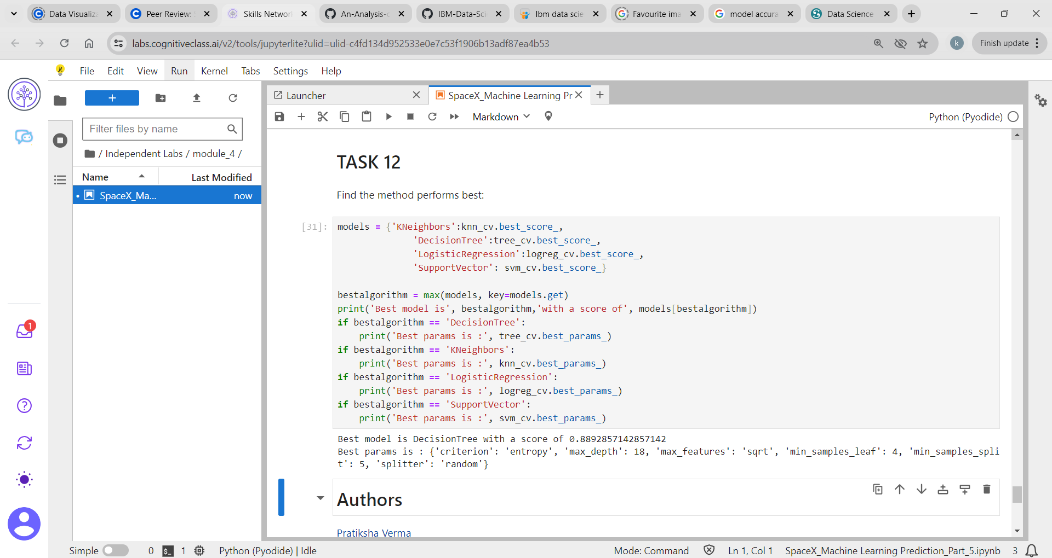
Classification Accuracy : Decision tree classifier is the model with the highest classification accuracy

Slide 47
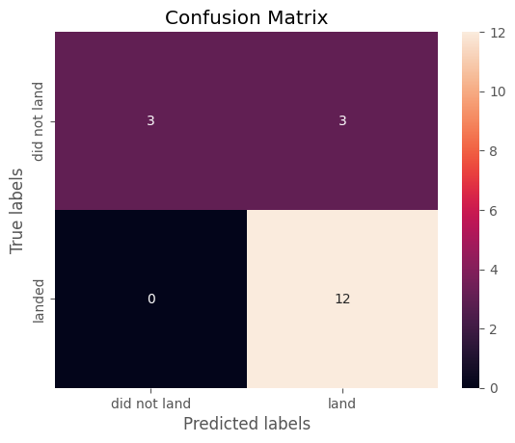
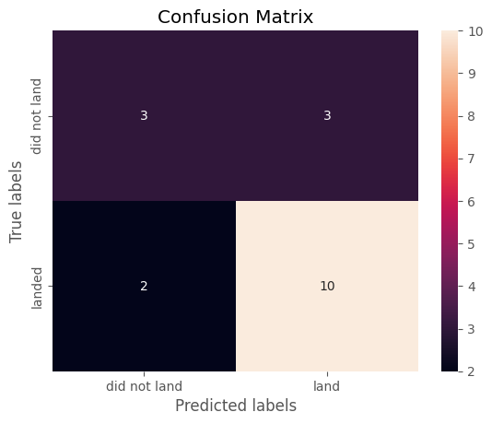

Confusion Matrix : K- nearest neighbour, Decision tree classifier, Logistic regression , Support vector machine .The accuracy of all the matrixs on the test data using method score is same except the Decision tree classifier.

Slide 48
Conclusion:
The larger the flight amount at a launch site, the greater the success rate at a launch site.
Launch success rate started to increase in 2013 till 2020
Orbits ES-L1,GEO,HEO,SSO,VLEO had the most success rate.
KSC LC-39A had the most successful launches of any sites.
The decision tree classifier is the best machine learning algorithm for this task.

Slide 49
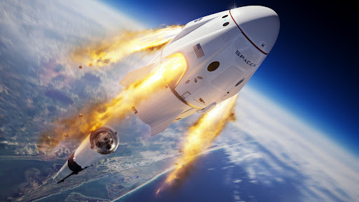
THANK YOU

